Slide 1

Meet the Teacher –
Year 3

Slide 2
Meet the Y3 Team
Mrs Kent - Class Teacher (4 days)
Mrs Clarke – Class Teacher (1 day)
Mrs Druce – Teaching Assistant
Mr Tattersfield – Teaching Assistant

Slide 3
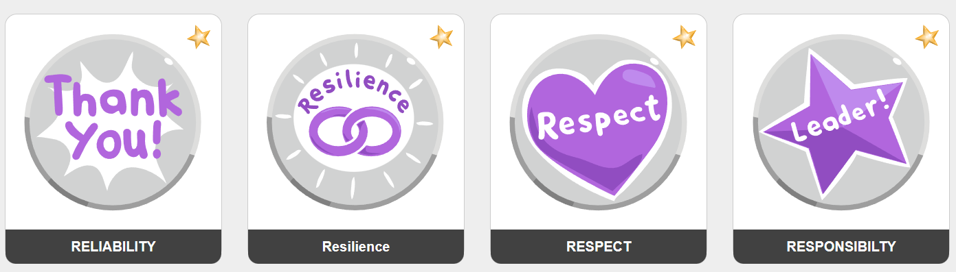
Our school values
We lead with nurture

Slide 4
Marvellous Me
Informs parents about current learning and exciting opportunities in the classroom
Provides reminders about upcoming class / school events
Acts as a celebration platform where teachers share badges and thumbs up (house points)
Instant notifications for parents
Celebrated weekly in assembly
Creates a year book, each year, for child to revisit

Slide 5
Communication
Teacher on the door, morning and afternoon
Fortnightly bulletin
Website calendar which you can subscribe to
Parentmail
Marvellous Me
Emails to class teacher via the office (We aim to reply within 48 hours)
Refer to communication policy https://primarysite-prod-sorted.s3.amazonaws.com/roundwood-primary-school-redesign/UploadedDocument/018ce376-38db-41c1-83c0-a86f0b5b2a63/communications-final.pdf
Notes:
Teacher on the door – quick messages for anything else, please email the office. Teachers aim to respond within 48hours.

Slide 6
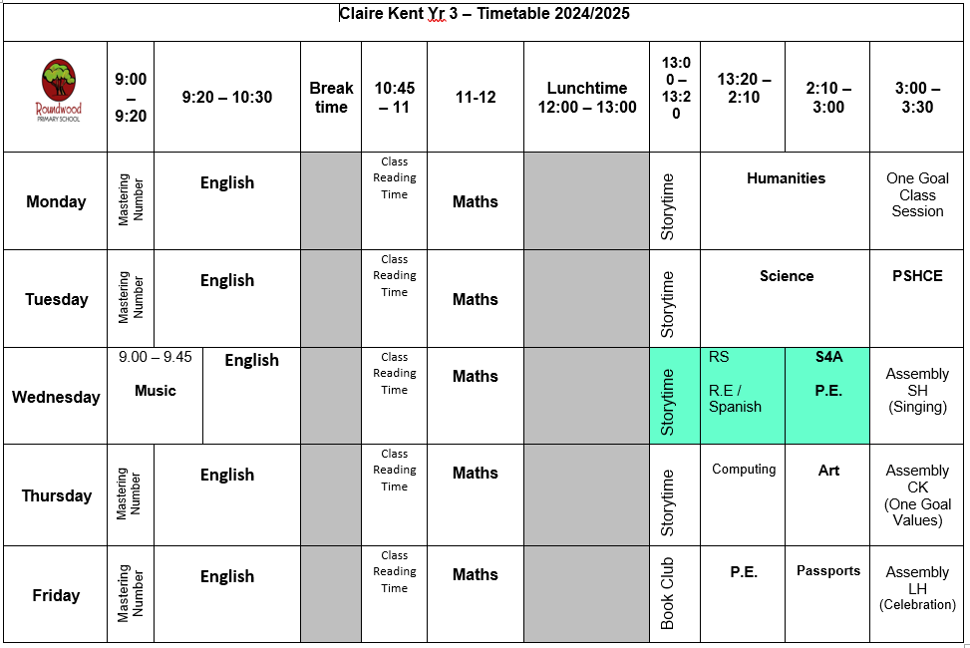
Example timetable

Slide 7
Our Curriculum

Slide 8
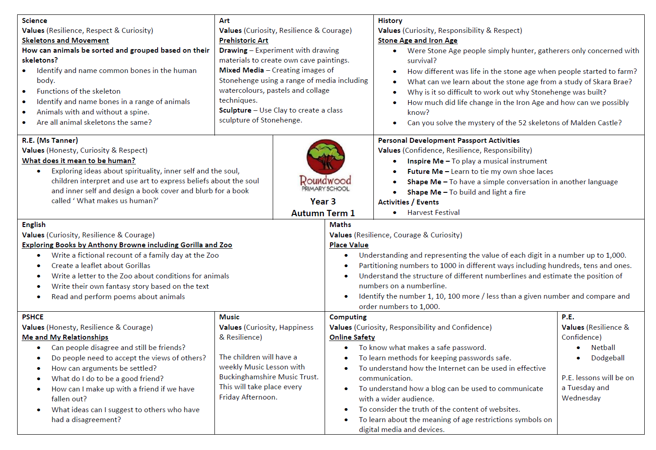
Please see all curriculum maps on our website

Slide 9
Assessments
We carry out assessments each term to help us to identify the areas of the curriculum the children have a secure understanding of and those things that need further teaching.
These assessments are used alongside our observations of the children and the progress they are making within lessons to inform the attainment and progress information we share with you.
Multiplication Check
Children in Year 4 are required to complete the statutory multiplication check in June. This assesses the children’s fluency of all times table facts.
This was introduced because knowledge of times table facts underpins many areas of learning and so having a secure understanding and recall of them supports progress in many areas of Maths.

Slide 10
Homework – KS2
Numbots (if advised) to practise addition and subtraction facts
TT Rockstars & Flashcards to develop Times Table fluency
HFW / Spellings
Reading books will be changed on a Monday. House Points will be awarded for reading regularly at home.
Homework Activity Grids – shared at the beginning of each half term to enrich the children’s learning.
Please see our Parent’s Guide to Homework
Notes:
I will share paper copies of Parent Guide.

Slide 11


Reading

Slide 12
Proposed Trips and Events
Autumn Term
TBC
Spring Term
TBC
Summer Term
The Living Rainforest, Berkshire estimated cost £30

Slide 13

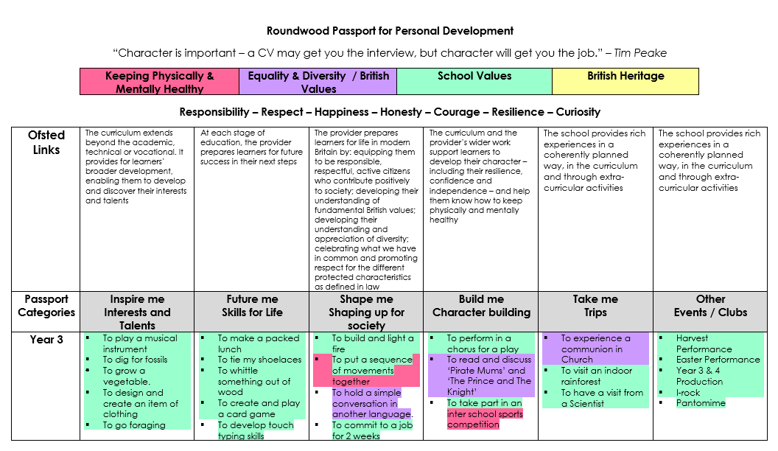
Personal Development

Slide 14
Useful Information – Gawcott
Start of day is 9:00am
End of day is 3:30pm
Wraparound care run by S4A
Breakfast club open from 7:30am
After school club open until 6:00pm
To book a session in S4A breakfast club or after school club. Go to the S4A website and click on Roundwood school

Slide 15
Useful Information – Gawcott
Reading books and reading records should be brought to school everyday.
Toys and items from home should not be brought into school.
Cloakroom space is very limited. Small Bags only with essentials
Small Pencil Cases can be brought in containing colouring pencils and felt pens. Teacher’s discretion will be used on when they can be used.
Medical conditions / allergies must be detailed on a healthcare plan and medication provided in original packaging.
If anyone else is picking your child up, please e-mail or call the school office otherwise we will not be able to send your child home

Slide 16
PE & Games – Gawcott
PE is on a Wednesday and a Friday
Please bring your P.E. kit to school in a drawstring bag.
Please make sure you wear the correct school uniform for PE this includes trainers and not dress down clothes

Slide 17
Uniform – Gawcott
Red sweatshirt or cardigan with school logo
Plain white polo shirt or plain white blouse
Grey skirt/pinafore/trousers/shorts; traditional school style
Grey short socks
White long socks
Red or grey tights
Black leather (or alternative) school shoes (not trainers)
Red and white gingham dress or playsuit
All children require a water bottle and wellington boots / outdoor shoes

Slide 18
Uniform – Expectations
Long hair / and or fringes must be tied or clipped back
Studs for pierced ears (must be covered or removed for P.E.)
No other jewellery permitted (unless for religious reasons)
No make up or nail varnish
No extreme hair cuts e.g. mullets / close shaven
No hair dye

Slide 19
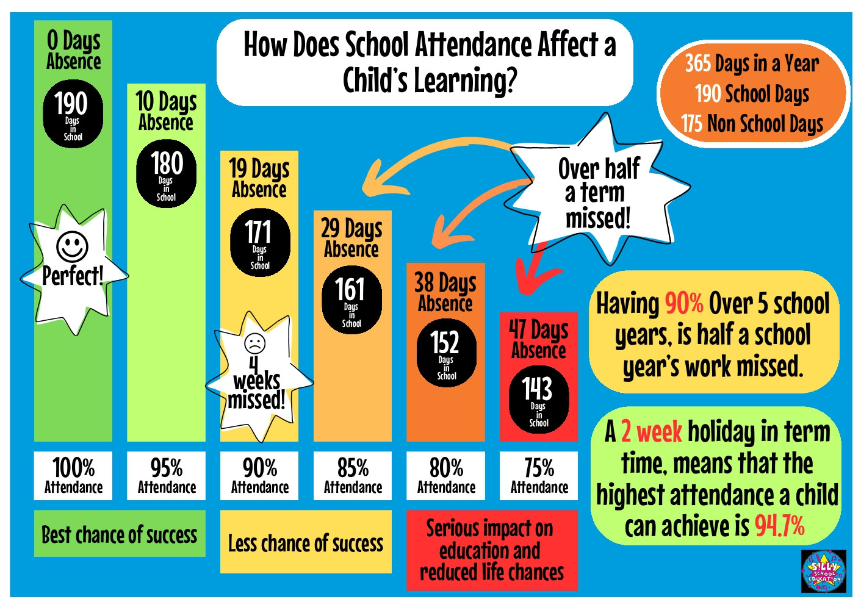
Attendance – it really does matter!

Slide 20
Behaviour
We have high expectations of behaviour at Roundwood School and expect all member of our school community to behave in a polite and respectful manner towards each other. This is rewarded through Marvellous Me.
All incidents of inappropriate behaviour are recorded on our CPOMS behaviour system and are monitored by senior members of staff.
Any incidents involving physical or inappropriate behaviour or language, sexualised behaviour, swearing or unkindness that could lead to suspected bullying will be reported to parents.
We are launching a kindness campaign in September to help us stamp out low level unkind behaviours – we will ask for your support with this

Slide 21
Support from home
Make sure your child arrives on time each morning
Provide an appropriate bedtime routine to ensure children are getting enough sleep and come to school ready to learn.
Support your child with reading, spelling and homework
Empty bookbags / bags
Keep us informed of anything that may affect your child’s learning or happiness
Regularly check Marvellous Me, Parentmail and school calendar on the school website

Slide 22
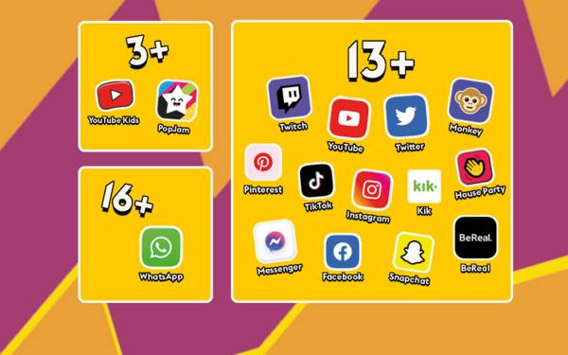
Online safety
Help us to keep your child ‘a child’ for as long as possible
Trends in behaviour show that children are far too aware of adult topics /language as a direct result of social media access
Check your child’s phone / electronic devices regularly

Slide 23
Hot meals / Packed lunches
If you would like your child to receive hot meals, please ensure you order from fresh start directly – information on the website
If your child does not want a hot meal, you can provide them with a packed lunch.
Please apply for Free School Meals if you receive any form of benefit – contact the school office for more information

Slide 24
Contact us – Gawcott
If you would like to contact any member of staff please send to office@Roundwood.bucks.sch.uk with FAO and Mrs Tattersfield will forward it to the correct member of staff for you.
Teachers will aim to respond to all emails within 48 hours, depending on the matter to be discussed.
Alternatively, please call 01280 848306

Slide 25

Questions

