Slide 1

Meet the Teacher –
Year 6

Slide 2
Meet the Y6 Team
Mrs Longton- Class Teacher (Tuesday to Friday)
Mrs Readings- Class Teacher (Mondays)
Mrs Lampard- Teaching Assistant
Mrs Palmer- Teaching Assistant

Slide 3
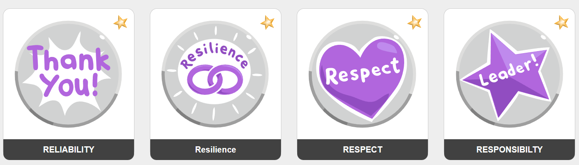
Our school values
We lead with nurture
Notes:
We aim to:
Inspire our children with the best the world has to offer whilst igniting a passion for learning, along with their enthusiasm and curiosity to explore
Challenge our children so that they strive to achieve their best, and to think to remember.
Grow our children so that they can converse, share in relationships and academically succeed beyond their time with us; being truly motivated by the successes and development they have made over time.

Slide 4
Marvellous Me
Informs parents about current learning and exciting opportunities in the classroom
Acts as a celebration platform where teachers share badges and thumbs up (house points)
Instant notifications for parents
Celebrated weekly in class assembly
Creates a year book, each year, for child to revisit

Slide 5
Communication
Teacher on the door, morning and afternoon
Fortnightly bulletin
Website calendar which you can subscribe to
Parentmail
Marvellous Me
Emails to class teacher via the office
Please refer to our Communication policy for more details: https://www.roundwood.bucks.sch.uk/policies

Slide 6
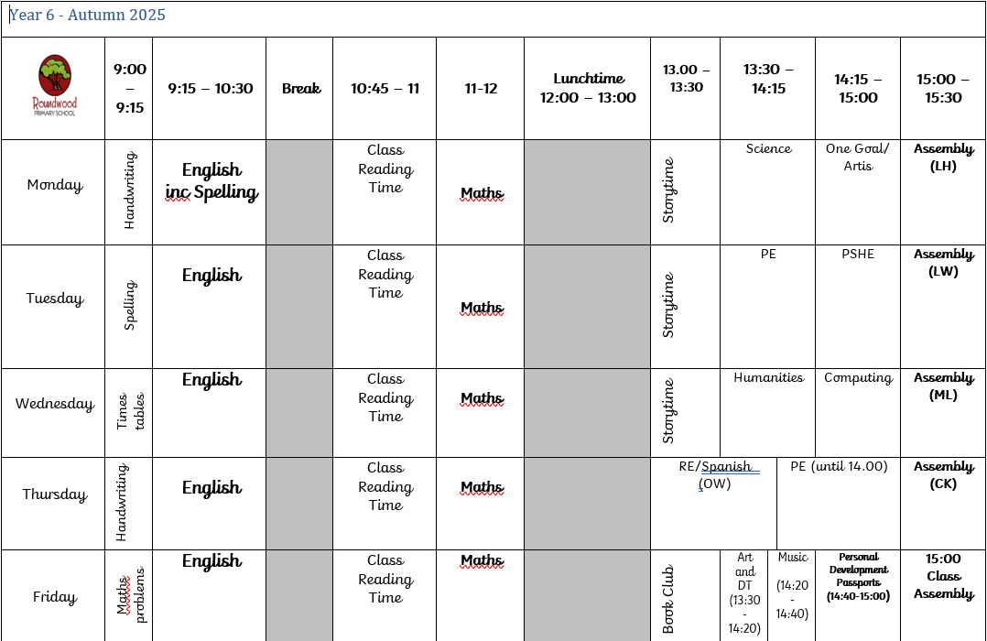
Our Timetable

Slide 7
Our Curriculum

Slide 8
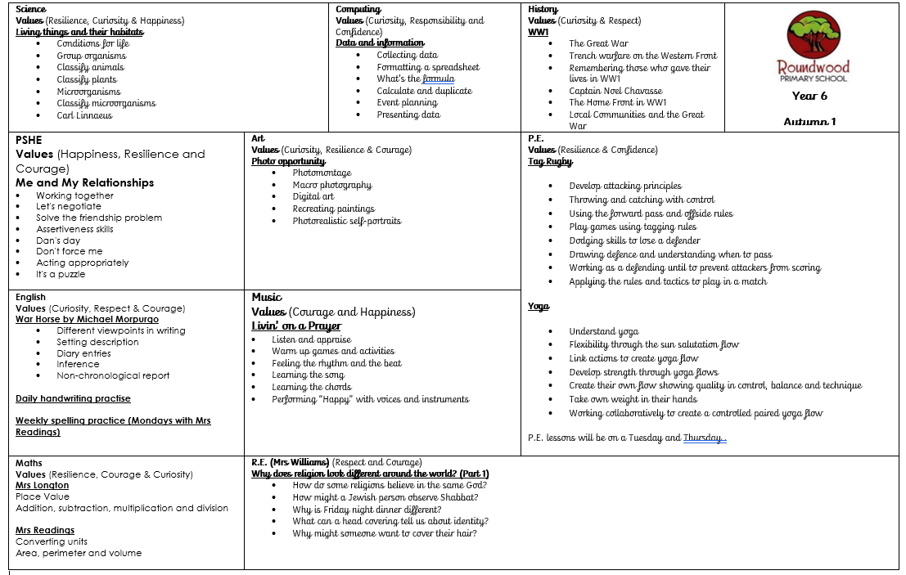
Autumn 1

Slide 9
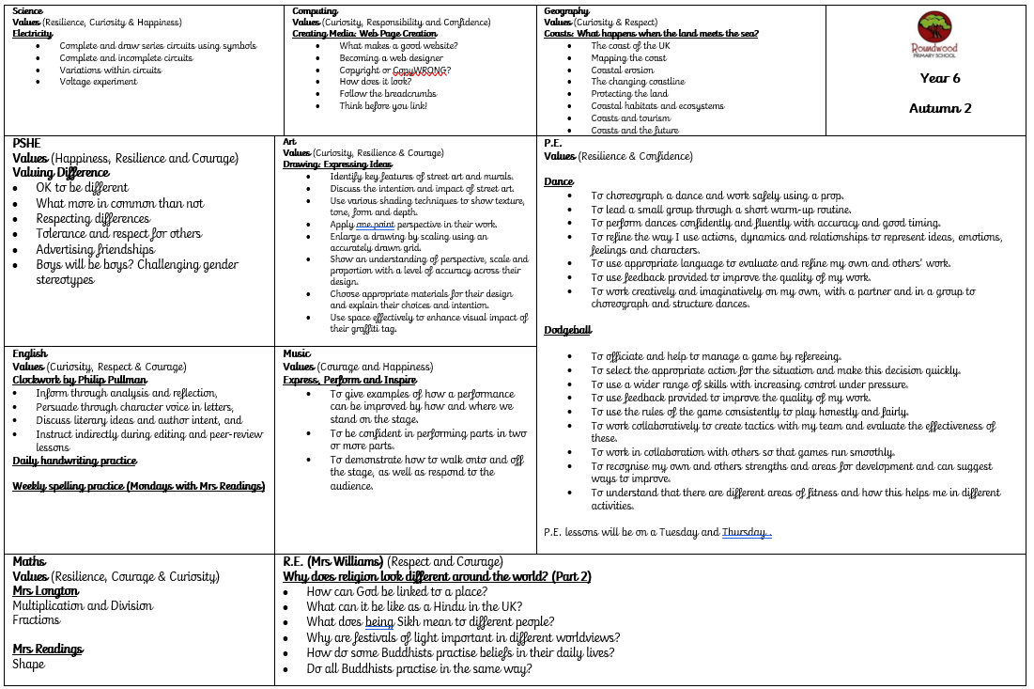
Autumn 2

Slide 10
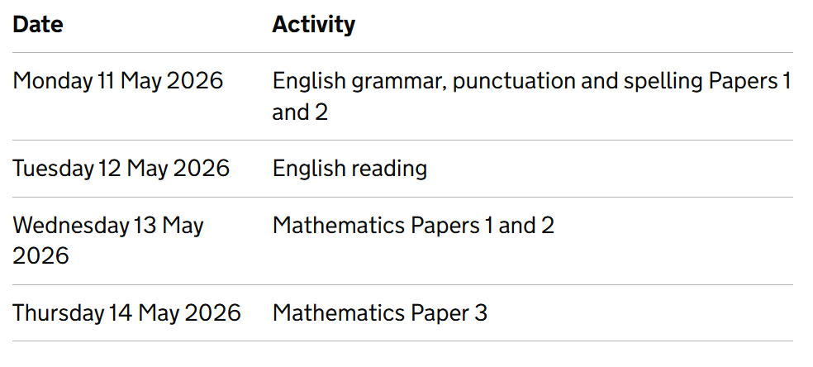
Assessments
Termly Assessment
We complete assessments each term to identify areas of the curriculum the children have a secure understanding of and next steps.
SATs
Children in Year 6 are required to complete SATs in May 2026. They will take place as follows:

Slide 11
Homework
TT Rockstars
Learning By Questions- Online platform used to set bespoke homework every week.
HFW / Spellings are sent home in Homework Books
Children are expected to read for 15/20 minutes every night and this should be recorded in their reading records.
Additional homework can be completed using the activities on our Dip and Do
https://www.roundwood.bucks.sch.uk/homework

Slide 12


Reading

Slide 13
Proposed Trips and Events
Manor Adventure- 3rd- 7th November 2025
Water Stratford Farm post SATs trip- 15th May 2026
Year 6 Performance – 15th July 2026
Treat Week- 20th – 22nd July 2026
Leavers’ Assembly – 21st July 2026

Slide 14
Useful Information
Start of day is 9:00am
End of day is 3.30pm
Wraparound care run by S4A
Breakfast club open from 7:30am
Afterschool club open until 6:00pm
To book a session in S4A breakfast club or after school club. Go to the S4A website and click on Roundwood school

Slide 15
Useful Information
PE kit may be worn to school on Tuesdays and Thursdays.
No toys or stationary to be brought in from home
Medical conditions / allergies must be detailed on a healthcare plan
If anyone else is picking your child up, please e-mail or call the school office otherwise we will not be able to send your child home

Slide 16
PE & Games
PE is on a Tuesday and Thursday
Please send your child into school wearing their PE kit
Please make sure you child wears the correct uniform for PE, and not dress down clothes

Slide 17
Uniform
Red sweatshirt or cardigan with school logo
Plain white polo shirt or plain white blouse
Grey skirt/pinafore/trousers/shorts; traditional school style
Grey short socks
White long socks
Red or grey tights
Black leather school shoes (not trainers)
Red and white gingham dress or playsuit
All children require a rucksack, water bottle and wellington boots

Slide 18
Uniform – Expectations
Long hair / and or fringes must be tied back
Studs for pierced ears
No other jewellery permitted (unless for religious reasons)
No make up
No nail varnish
No extreme hair cuts e.g. mullets / close shaven
No hair dye

Slide 19
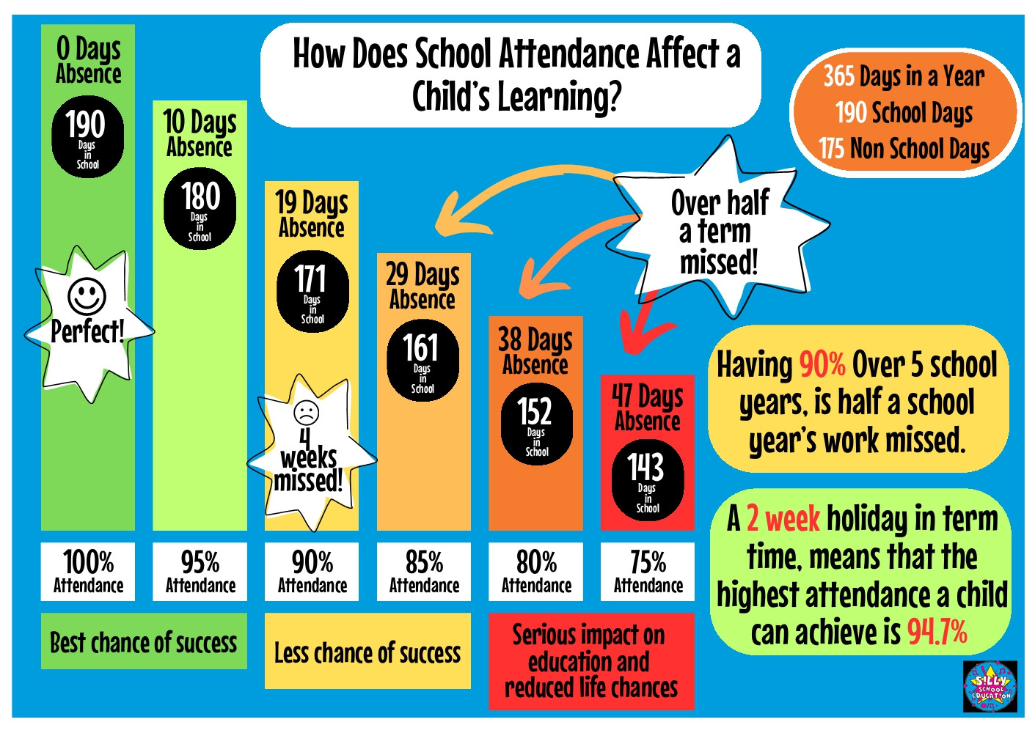
Attendance – it really does matter!
Notes:
Please be awae that

Slide 20
Support from home
Make sure your child arrives on time each morning
Support your child with reading, spelling and homework
Empty bags
Keep us informed of anything that may affect your child’s learning or happiness
Regularly check Marvellous Me, LbQ, Parentmail and school calendar on the school website

Slide 21
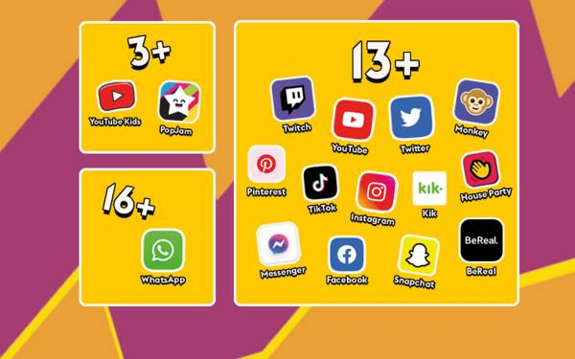
Online safety
Help us to keep your child ‘a child’ for as long as possible
Trends in behaviour show that children are far too aware of adult topics /language as a direst result of social media access
If your child has a device or phone, please check it regularly

Slide 22
Hot meals / Packed lunches
Hot meals are provided free of charge to all children up to Year 2.
Hot meals are payable for Years 3 – 6 unless in receipt of Pupil Premium funding.
If your child does not want a hot meal, you can provide them with a packed lunch.
If you would like your child to receive hot meals, please ensure you order from fresh start directly – information on the website

Slide 23
Contact us
If you would like to contact any member of staff please send to office@Roundwood.bucks.sch.uk with FAO and Mrs Tattersfield will forward it to the correct member of staff for you
Alternatively, please call 01280 848306

