Slide 1

Meet the Teacher
Year 2

Slide 2

Meet the Y2 Team
Mrs Thomson– Class teacher (3 day)
Mrs Readings - Class teacher (2 days)
Mrs Back– Teaching Assistant

Slide 3
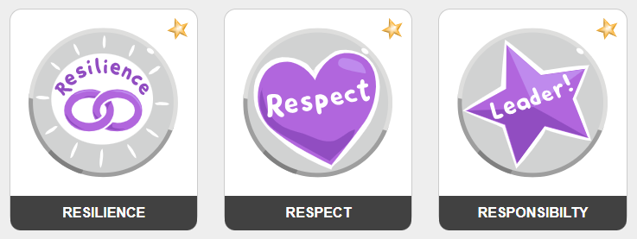
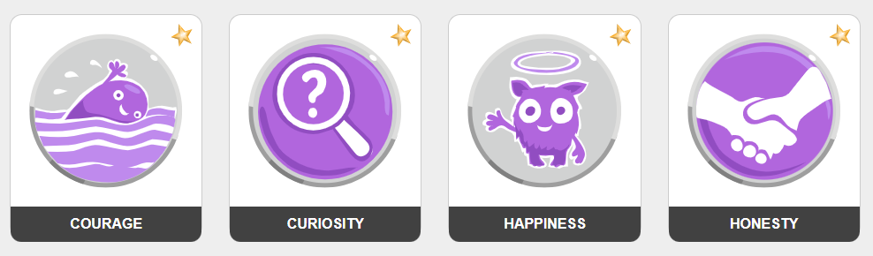
Our school values
We lead with nurture
Notes:
We aim to:
Inspire our children with the best the world has to offer whilst igniting a passion for learning, along with their enthusiasm and curiosity to explore
Challenge our children so that they strive to achieve their best, and to think to remember.
Grow our children so that they can converse, share in relationships and academically succeed beyond their time with us; being truly motivated by the successes and development they have made over time.

Slide 4

Marvellous Me
Informs parents/carers about current learning and exciting opportunities in the classroom
Acts as a celebration platform where teachers share badges and thumbs up
Instant notifications to parents/carers
Celebrated weekly in assembly
Creates a year book, each year, for child to revisit
Will send reminders on here for whole class

Slide 5

Communication
Teacher on the door, morning and afternoon
Fortnightly bulletin
Website calendar which you can subscribe to
Parentmail
Marvellous Me
You can send emails to class teacher via the office
Refer to communication policy https://primarysite-prod-sorted.s3.amazonaws.com/roundwood-primary-school-redesign/UploadedDocument/018ce376-38db-41c1-83c0-a86f0b5b2a63/communications-final.pdf

Slide 6
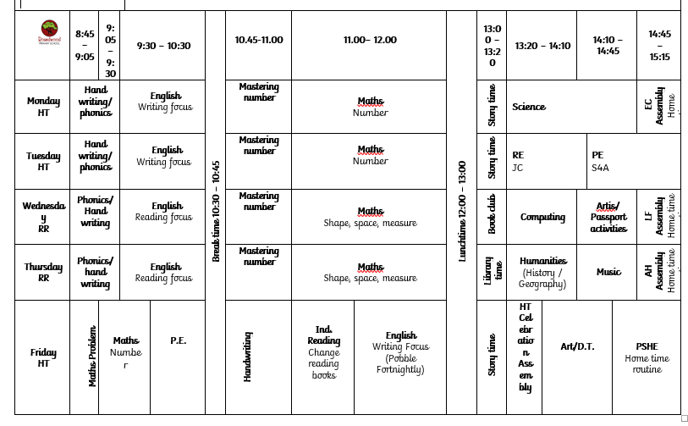
Our Timetable

Slide 7
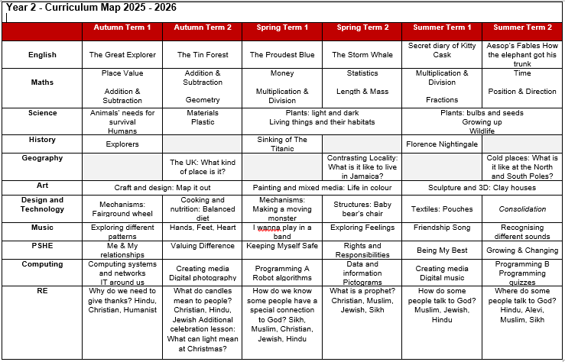
Our Curriculum

Slide 8

PE & Games
PE is on a Tuesday and a Friday
Children to come dressed in their PE Kit on both days
Please make sure they wear the correct uniform for PE, and not dress down clothes

Slide 9


Reading

Slide 10

Useful Information
Start of day is 8:45am
End of day is 3:15pm
Wraparound care run by S4A
Breakfast club open from 7:30am
Afterschool club open until 6:00pm
To book a session in S4A breakfast club or after school club.
Go to the S4A website and click on Roundwood school

Slide 11
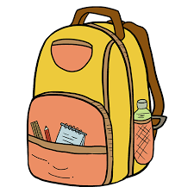
Useful Information
Book bags – rucksacks are not permitted
No toys or stationery to be brought in from home
Medical conditions / allergies must be detailed on a healthcare plan
If anyone else is picking your child up, please e-mail or call the school office to inform us

Slide 12

Homework – KS1
Numbots
Reading 4 x a week
HFW / Spellings (Half termly tests sent home for families to work on the errors)
Reading diaries will be checked once a week (children will be encouraged to change their own books as the year progresses)
Additional homework can be completed – by utilising our Dip and Do

Slide 13

Proposed Trips and Events
Autumn Term: Giant Journeys VR Space Experience estimated cost £4
Summer Term 1: History off the Page - Florence Nightingale day (In school) estimated cost £23.
Summer Term 2: Stowe Gardens – End of year treat, watercolour painting and team games estimated cost £3.

Slide 14

Assessments
Optional SATS in Summer 2
Reading paper x 2
Maths paper x 2
SPAG x 1

Slide 15
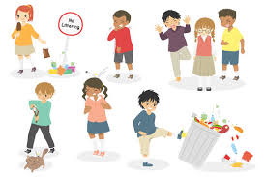
Behaviour
All behaviour incidents are reported on our CPOMS behaviour system
Any physical incidents and swearing will receive a call home

Slide 16

Home support
Make sure your child arrives on time each morning
Support your child with reading, spelling and homework
Regularly check and empty bookbags / bags
Keep us informed of anything that may affect your child’s learning or happiness
Regularly check Marvellous Me/Parentmail/School calendar

Slide 17

Uniform
Red sweatshirt/cardigan with school logo
Plain white polo shirt or plain white blouse
Grey skirt/pinafore/trousers/shorts; traditional school style
Grey short socks/white long socks
Red or grey tights
Black leather school shoes (not trainers)
Red and white gingham dresses or playsuit
All children require a bookbag, water bottle and wellies

Slide 18
Uniform – Expectations
Long hair / fringes must be tied back
Studs for pierced ears
No other jewellery permitted (unless for religious reasons)
No make up or nail varnish
No extreme hair cuts e.g. mullets / close shaven
No hair dye

Slide 19
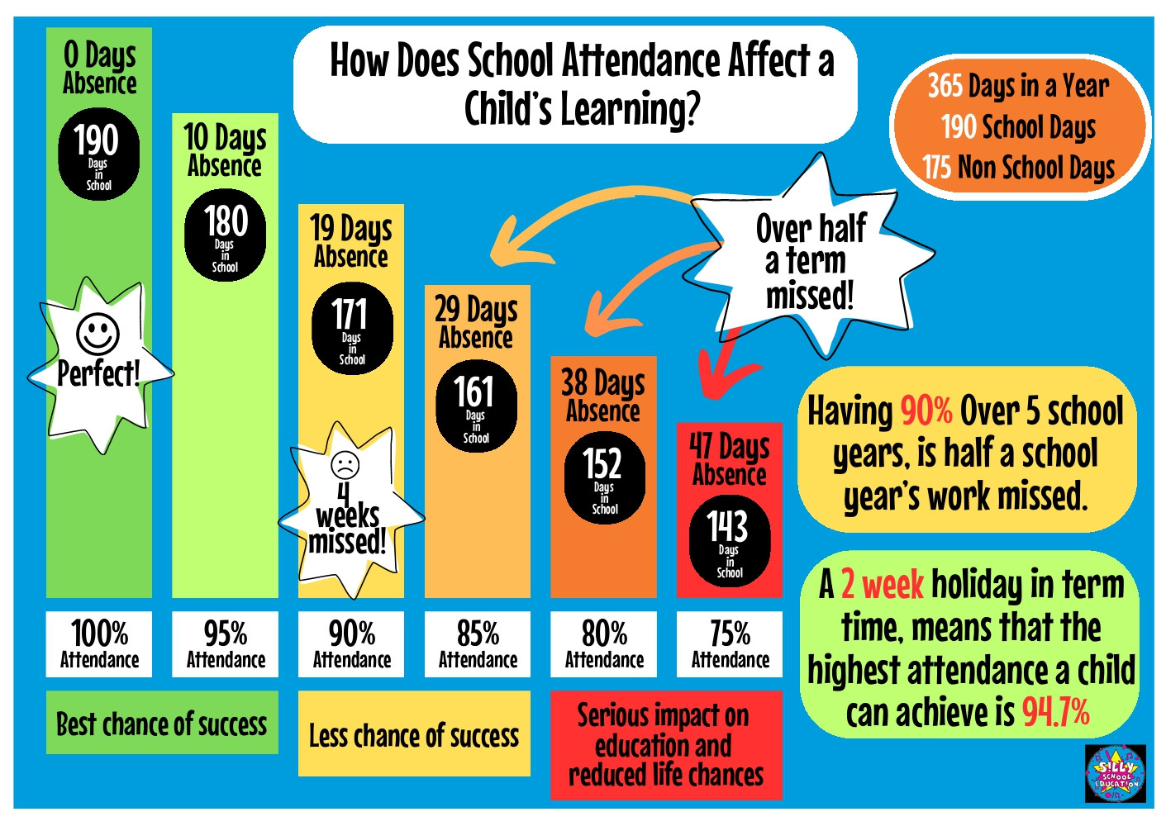
Attendance – it really does matter!
Notes:
Please be aware that attendance is monitored. If your child falls below 95% Mrs Handley will make contact with you to devise an attendance plan

Slide 20
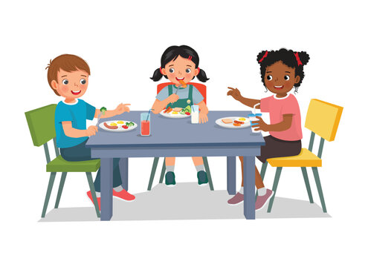
Hot meals / Packed lunches
Hot meals are provided free of charge to all children up to Year 2.
If your child does not want a hot meal, you can provide them with a packed lunch.
If you would like your child to receive hot meals, please ensure you order from fresh start directly – information on the website

Slide 21

Questions

