Slide 1

Welcome to
Year 1

Slide 2
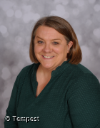
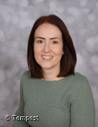
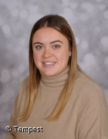
Meet the Y1 Team
Mrs Field
Class Teacher
Mrs Chambers
Teaching Assistant
Miss Connell
HLTA

Slide 3
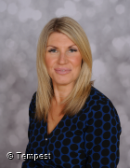
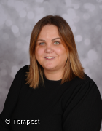
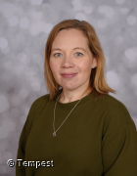
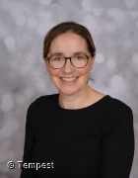
Other staff that will help you
Mrs Handley
Headteacher
Mrs Clarke
Deputy
Headteacher
Ms Tanner
SENDCo
Mrs Hall
School
Administrator

Slide 4
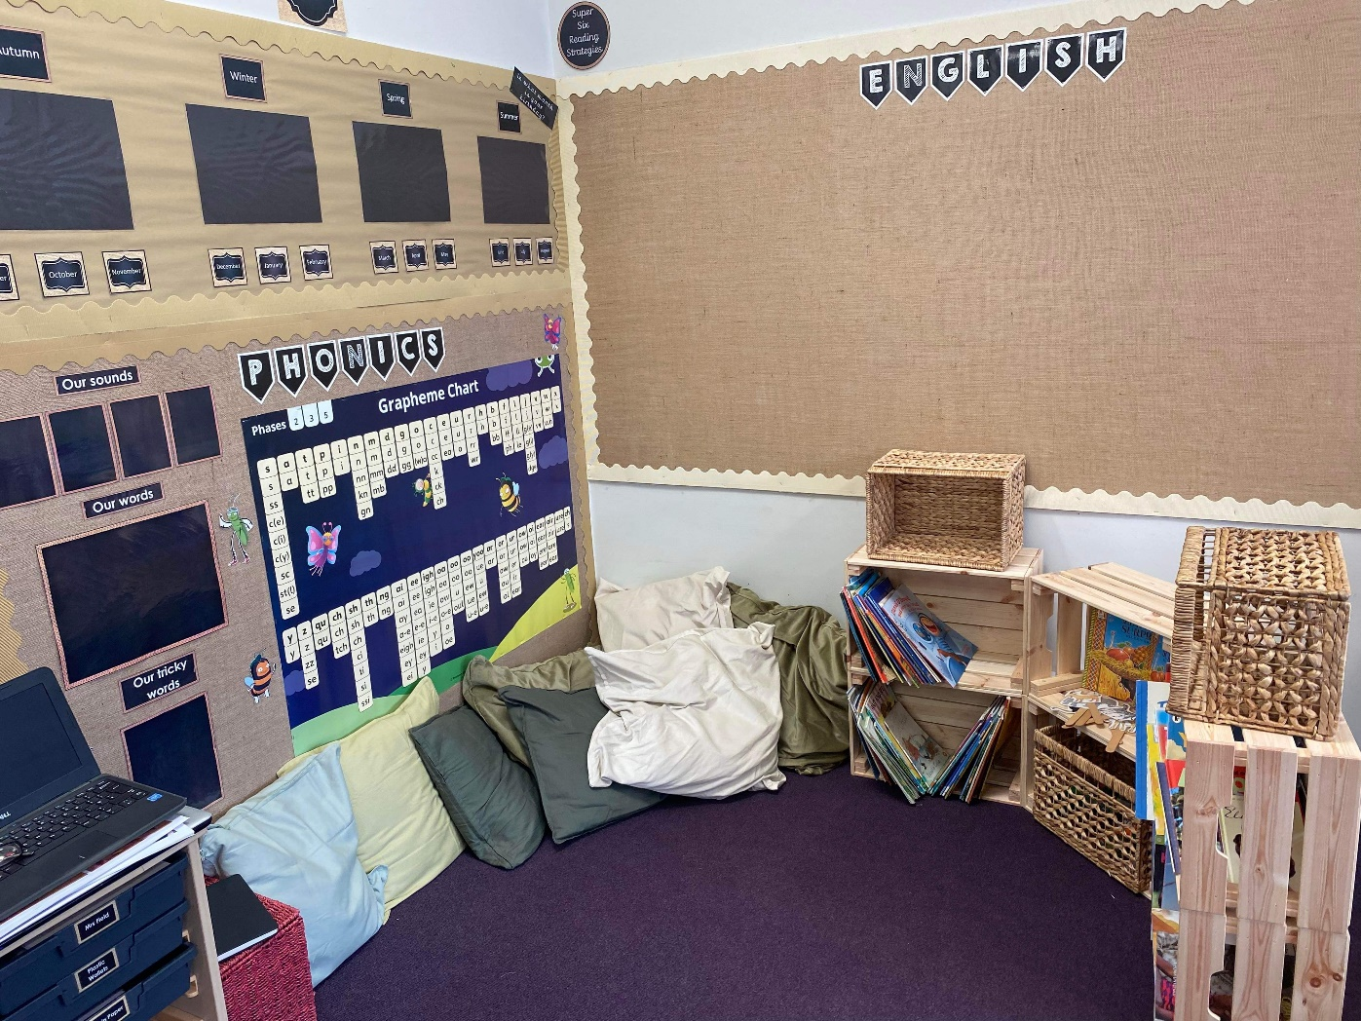
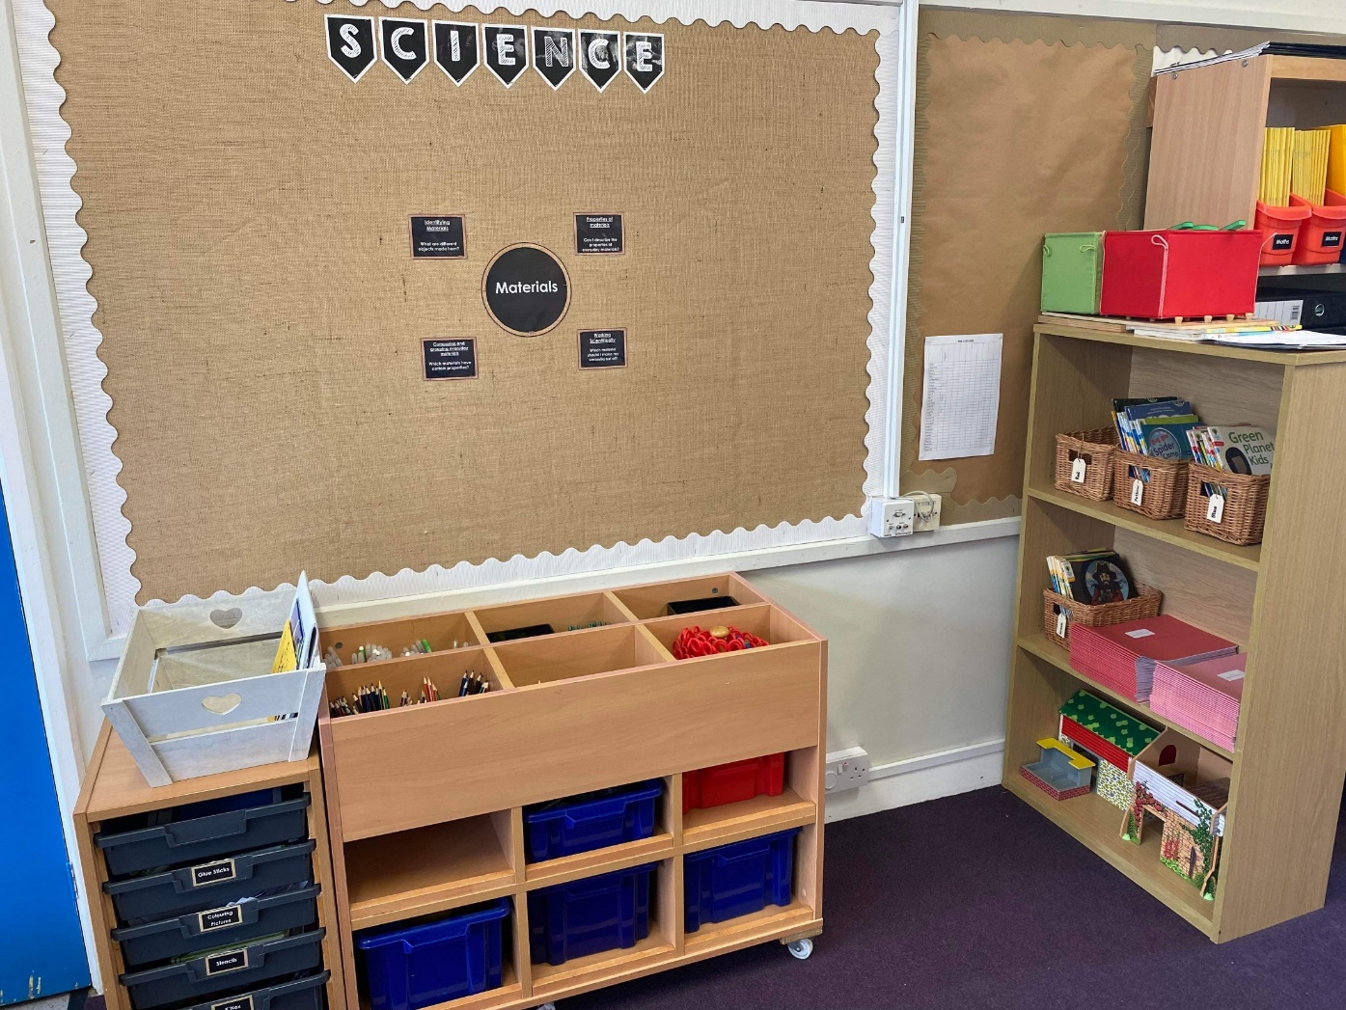
Our classroom

Slide 5
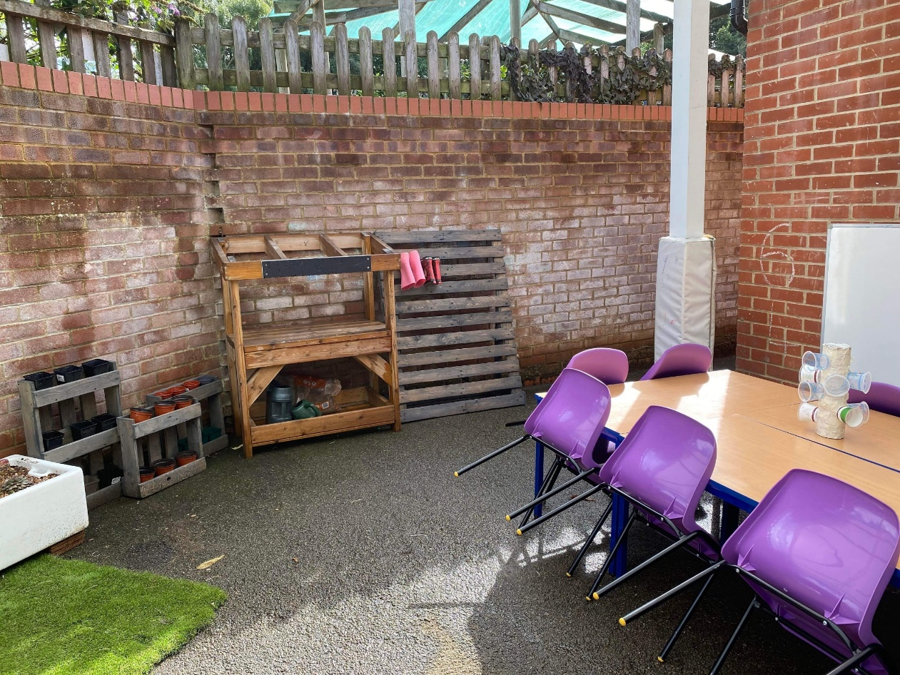
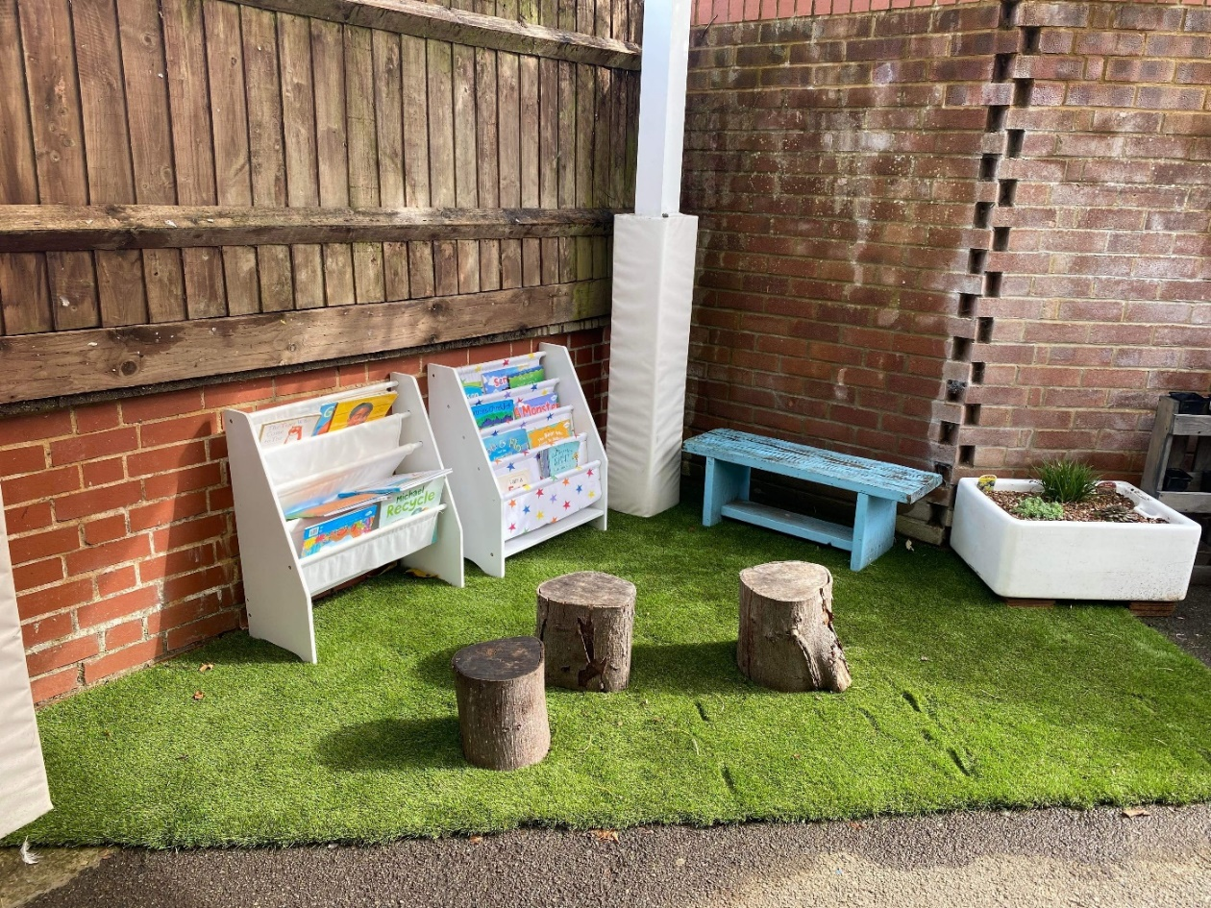
Our classroom

Slide 6
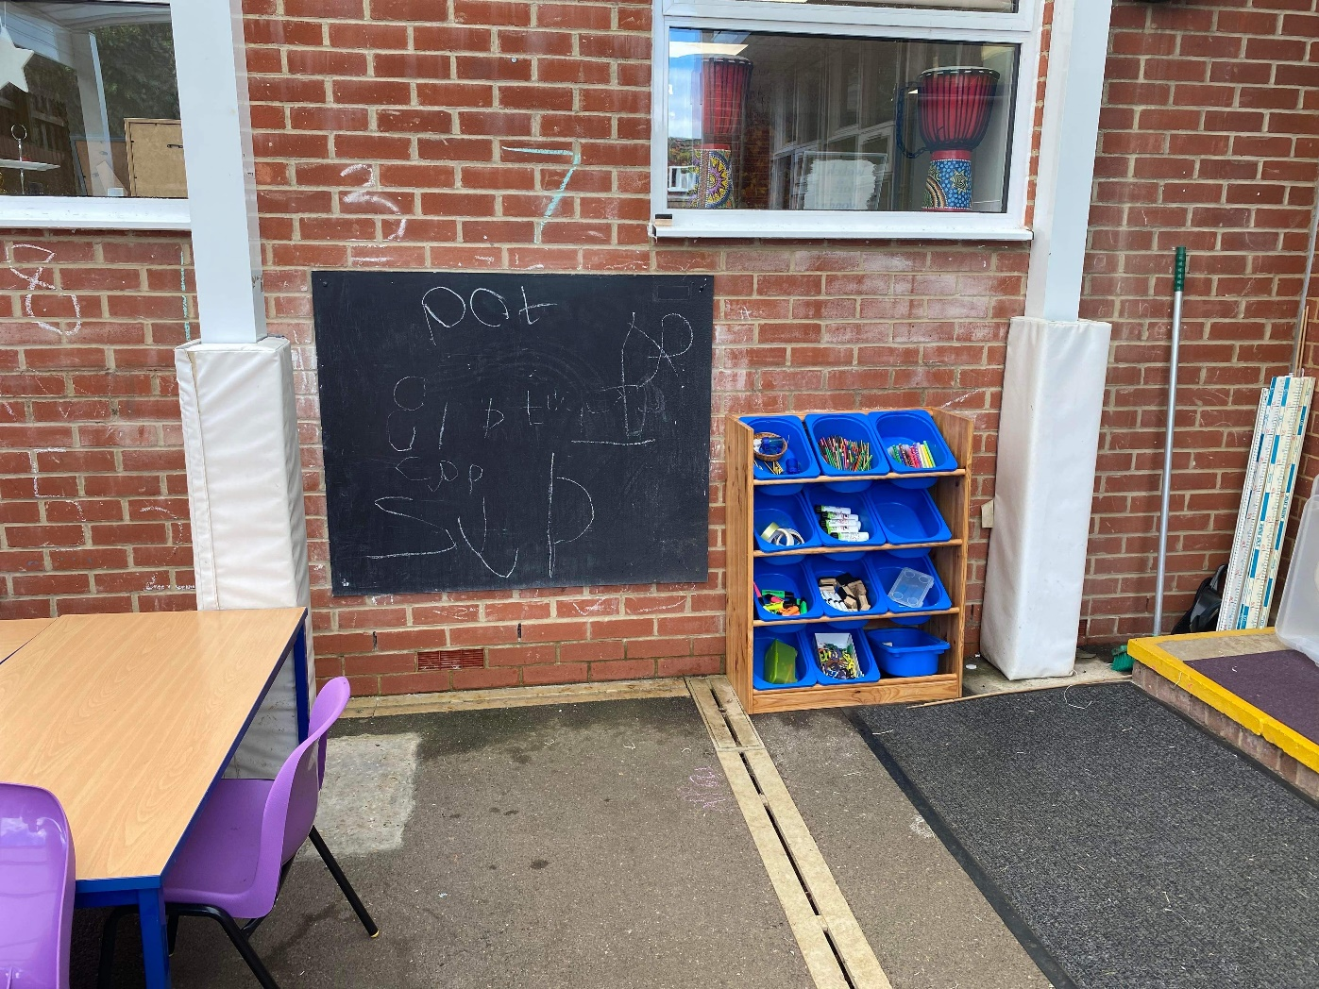
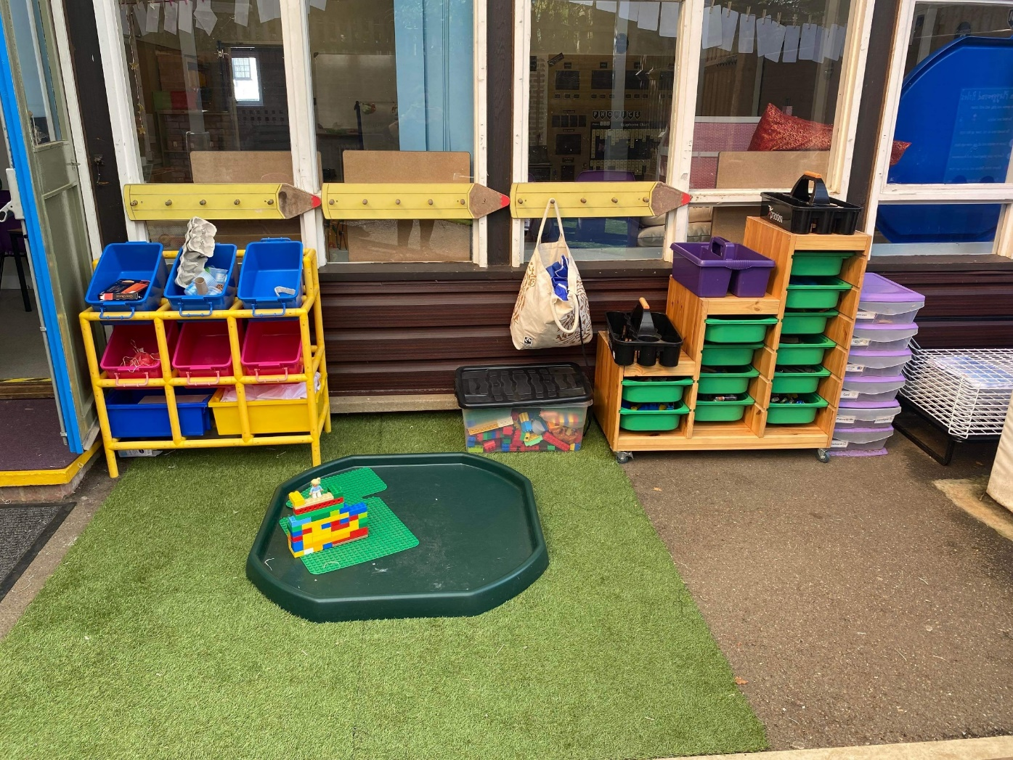
Our classroom

Slide 7
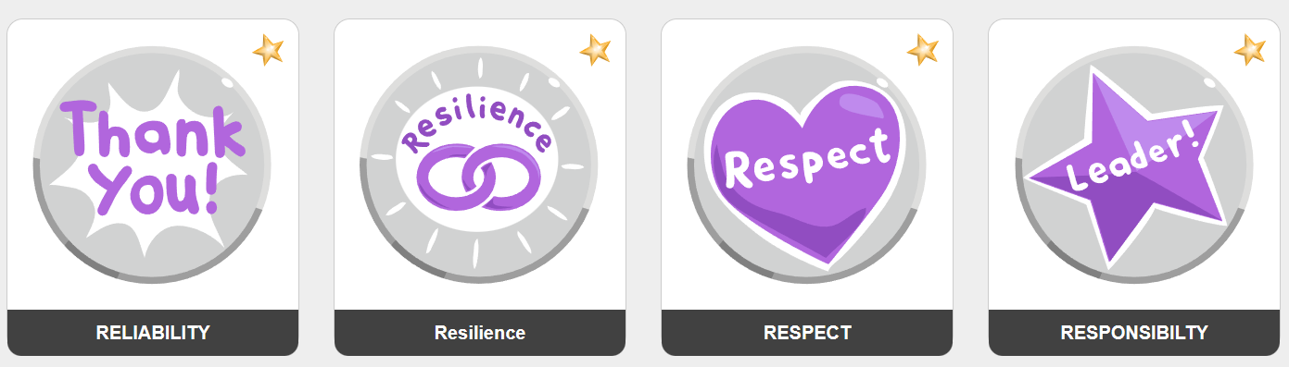
Our school Values
We lead with nurture

Slide 8
Marvellous Me
Informs parents about current learning and exciting opportunities in the classroom
Acts as a celebration platform where teachers share badges and thumbs up (house points)
Instant notifications for parents
Celebrated weekly in class assembly
Creates a year book, each year, for child to revisit

Slide 9
Communication
Teacher on the door, morning and afternoon
Fortnightly bulletin
Website calendar which you can subscribe to
Parentmail
Marvellous Me / Tapestry
Emails to class teacher via the office
Please refer to our Communication policy for more details: https://www.roundwood.bucks.sch.uk/policies

Slide 10
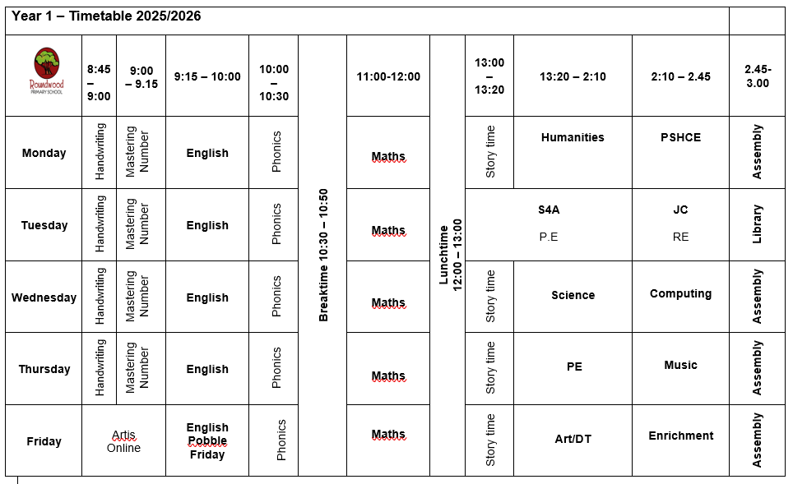
Timetable

Slide 11
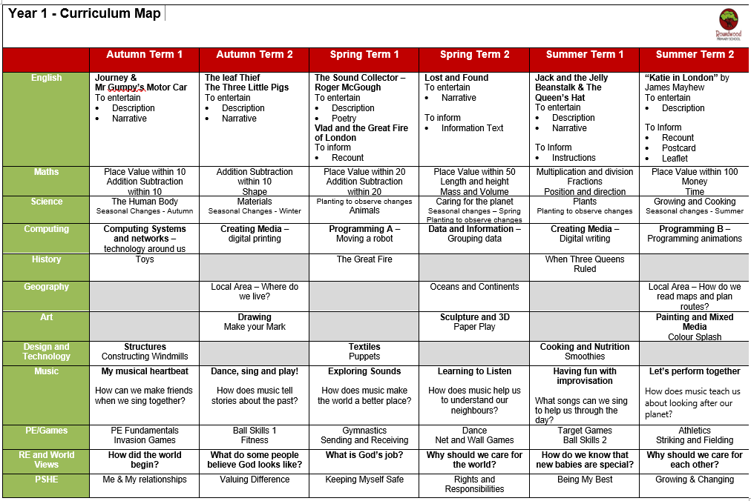
Our Curriculum

Slide 12
Our Curriculum
Click the link to view our half termly Learning Maps
https://www.roundwood.bucks.sch.uk/year-1-2

Slide 13
Assessments
Non Statutory Assessments
Spelling checks twice per half term and new lists allocated if needed
Allocation of the next reading scheme book band when appropriate
End of block assessment for maths
Half termly phonics checks to ensure on track
End of term maths and reading assessment papers
Practice phonics screening checks in spring 1 and summer 1
Statutory Assessments
Phonics Screening Check in June

Slide 14
Homework
Numbots – 15mins/week broken into several small sessions
Bug Club Phonics – books allocated to read online
HFW / Spellings – 10 spellings of high frequency and tricky words
Reading books and library books will be changed on a Tuesday
Additional homework can be completed – by utilising our Dip and Do
https://www.roundwood.bucks.sch.uk/homework

Slide 15


Reading

Slide 16
Proposed Trips and Events
Library visit in Buckingham – no cost
Waddesdon – Garden Explorers – approx. £9
Cotswold Wildlife Park – approx. £30-£35
Other local visits around the village will take place throughout the year at no cost.

Slide 17
Useful Information
Start of day is 8:45am
End of day is 3:15pm
Wraparound care is run by S4A
Breakfast club opens from 7:30am
Afterschool club opens until 6:00pm
To book a session in S4A breakfast club or after school club. Go to the S4A website and click on Roundwood school

Slide 18
Useful Information
Book bags only – the cloakroom is not big enough to accommodate rucksacks unless it is forest school days.
No toys or stationary to be brought in from home
Medical conditions / allergies must be detailed on a healthcare plan
If anyone else is picking your child up, please e-mail or call the school office otherwise we will not be able to send your child home

Slide 19
PE & Games
PE is on a Tuesday and Thursday
Please send your child into school wearing their PE kit
Please make sure your child wears the correct uniform for PE, and not dress down clothes.
    Red Roundwood PE shirt
    Black shorts
    Black track suit
    Trainers

Slide 20
Uniform
Red sweatshirt or cardigan with school logo
Plain white polo shirt or plain white blouse
Grey skirt/pinafore/trousers/shorts; traditional school style
Grey short socks
White long socks
Red or grey tights
Black leather school shoes (not trainers)
Red and white gingham dress or playsuit in the summer
All children require a book bag, water bottle and wellington boots

Slide 21
Uniform – Expectations
Long hair / and or fringes must be tied back
Studs for pierced ears
No other jewellery permitted (unless for religious reasons)
No make up
No nail varnish
No extreme hair cuts e.g. mullets / close shaven
No hair dye

Slide 22
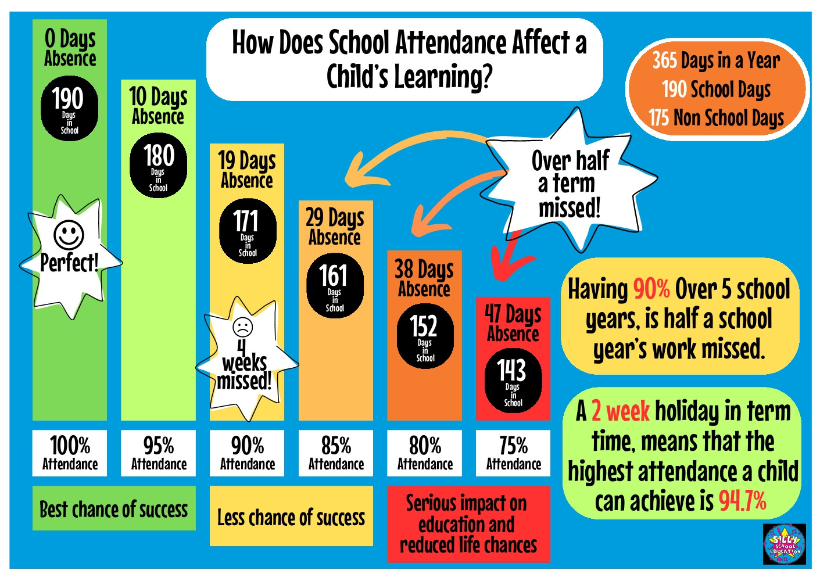
Attendance – it really does matter!
Notes:
Please be awae that

Slide 23
Support from home
Make sure your child arrives on time each morning
Support your child with reading, spelling and homework
Empty book bags
Keep us informed of anything that may affect your child’s learning or happiness
Regularly check Marvellous Me, Parentmail and school calendar on the school website

Slide 24
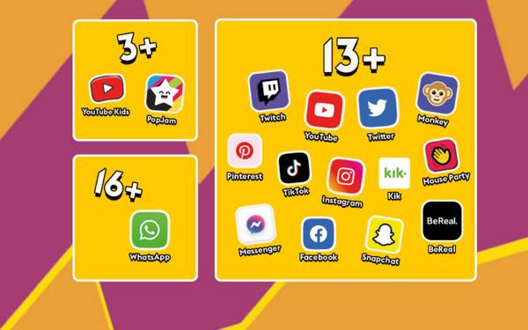
Online safety
Help us to keep your child ‘a child’ for as long as possible
Trends in behaviour show that children are far too aware of adult topics /language as a direst result of social media access
If your child has a device or phone, please check it regularly

Slide 25
Hot meals / Packed lunches
Hot meals are provided free of charge to all children up to Year 2.
Hot meals are payable for Years 3 – 6 unless in receipt of Pupil Premium funding.
If your child does not want a hot meal, you can provide them with a packed lunch.
If you would like your child to receive hot meals, please ensure you order from Fresh Start directly – information on the website

Slide 26
Contact us
At Tingewick, If you would like to contact any member of staff please send to admin@Roundwood.bucks.sch.uk with FAO and Mrs Hall will forward it to the correct member of staff for you
Alternatively, please call 01280 848306

