Slide 1

Meet the Teacher –
Foundation

Slide 2
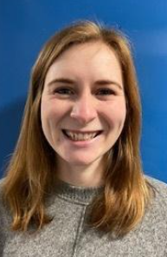
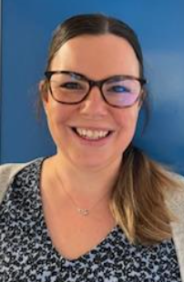
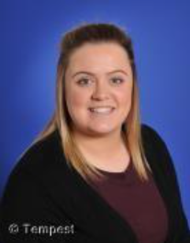
Meet the Foundation Team
Miss Hicks – Class Teacher (Tues-Fri) | Mrs Nichols – Teaching Assistant | Miss Connell – HTLA (Monday)

Slide 3
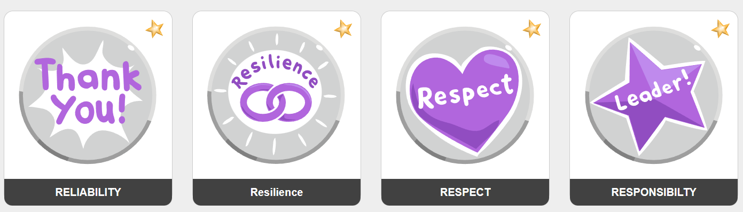
Our school values
We lead with nurture
Notes:
We aim to:
Inspire our children with the best the world has to offer whilst igniting a passion for learning, along with their enthusiasm and curiosity to explore
Challenge our children so that they strive to achieve their best, and to think to remember.
Grow our children so that they can converse, share in relationships and academically succeed beyond their time with us; being truly motivated by the successes and development they have made over time.

Slide 4
Tapestry
Secure online portal we use for sharing learning intentions, outcomes and celebrations throughout EYFS
App available
Updates you via email of new observations
You can upload your own observations – children love it when this happens!
You can have more than one parent per account
Self-help tutorials for parents online

Slide 5
Communication
Teacher on the door, morning and afternoon
Fortnightly bulletin
Website calendar which you can subscribe to
Parentmail
Tapestry
Emails to class teacher via the office
Please refer to our Communication policy for more details: https://www.roundwood.bucks.sch.uk/policies

Slide 6
Our Timetable (example day)
8:45 | Morning Activities Register
9:10 | Phonics
9:45 | Snack
10:15 | Choosing Time
11:35 | Story Lunch Routines Lunch at 11:45
13:00 | Register Mastering Number
13:30 | Choosing Time
15:00 | Story End of day routines
PE on Wednesdays
Library Time on Wednesdays
Reading books changed on Tuesdays
Cooking sessions on Friday

Slide 7
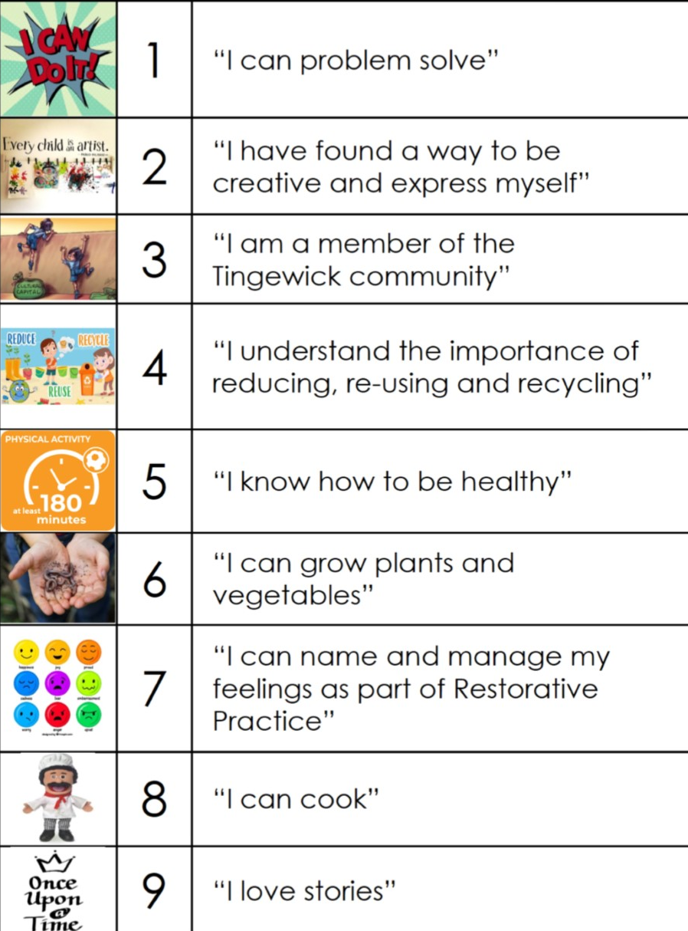
Our Curriculum

Slide 8
Assessments
Baseline Assessment completed at the start of the year to understand each child’s starting points.
Ongoing teacher assessments through observations, small group tasks, and individual work.
Phonics assessments carried out termly to track early reading skills.
Maths assessments through observations, small groups tasks and individual work.
Assessment against the Early Learning Goals (Summer)
Assessments are used to plan next steps and support individual learning needs.

Slide 9
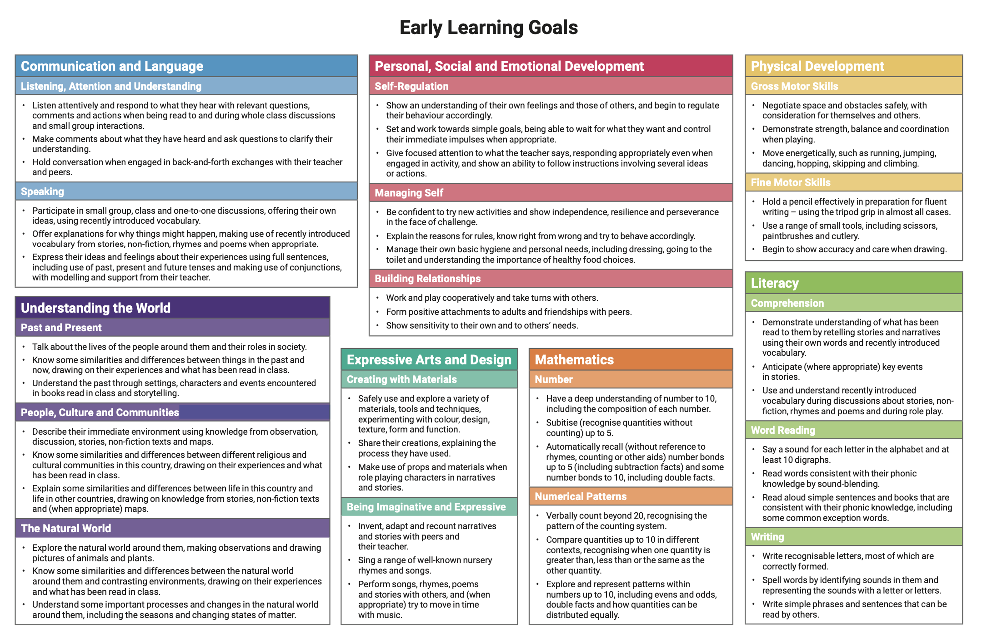
Early Learning Goals
Communication and Language
Personal, Social and Emotional Development
Physical Development
Literacy
Mathematics
Understanding the World
Expressive Arts and Design

Slide 10
Homework
No formal homework in Foundation
You can support your child’s learning by…
Reading with your child daily and talking about the story together. Reading books linked to our phonics scheme will be sent home and changed weekly.
Encouraging mark-making and early writing (drawing, writing their name, practising letters)
Practising counting and number recognition in everyday situations
Supporting independence skills (getting dressed, tidying up, using cutlery)
Talking with your child to develop vocabulary and confidence in speaking
Playing simple games that build turn-taking, listening, and problem-solving
Engaging in real-life learning (cooking, shopping, exploring outdoors)
Celebrating effort and encouraging a positive attitude to learning

Slide 11


Reading

Slide 12
Proposed Trips and Events
12th December Christmas Sing and Share
Spring Term – Trip to Waddesdon Manor
Summer Term – Trip to Hogshaw Farm

Slide 13
Useful Information
Start of day is 8:45am
End of day is 3:15pm
Wraparound care run by S4A
Breakfast club open from 7:30am
Afterschool club open until 6:00pm
To book a session in S4A breakfast club or after school club. Go to the S4A website and click on Roundwood school

Slide 14
Useful Information
Book bags only – rucksacks are not permitted
No toys or stationary to be brought in from home
Medical conditions / allergies must be detailed on a healthcare plan
If anyone else is picking your child up, please e-mail or call the school office otherwise we will not be able to send your child home

Slide 15
PE & Games
PE is on a Wednesday
Please send your child into school wearing their PE kit
Please make sure you child wears the correct uniform for PE, and not dress down clothes

Slide 16
Uniform
Red sweatshirt or cardigan with school logo
Plain white polo shirt or plain white blouse
Grey skirt/pinafore/trousers/shorts; traditional school style
Grey short socks
White long socks
Red or grey tights
Black leather school shoes (not trainers)
Red and white gingham dress or playsuit
All children require a bookbag, water bottle and wellington boots

Slide 17
Uniform – Expectations
Long hair / and or fringes must be tied back
Studs for pierced ears
No other jewellery permitted (unless for religious reasons)
No make up
No nail varnish
No extreme hair cuts e.g. mullets / close shaven
No hair dye

Slide 18
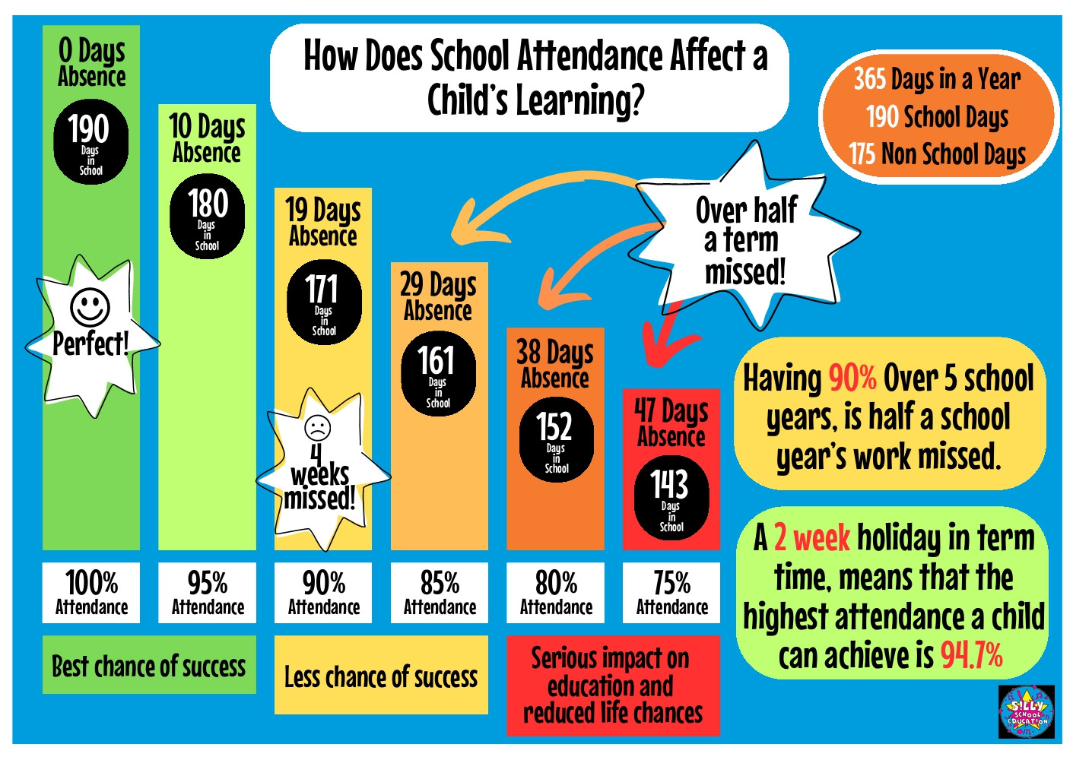
Attendance – it really does matter!
Notes:
Please be awae that

Slide 19
Support from home
Make sure your child arrives on time each morning
Support your child with reading, spelling and homework
Empty bookbags / bags
Keep us informed of anything that may affect your child’s learning or happiness
Regularly check Tapestry, Parentmail and school calendar on the school website

Slide 20
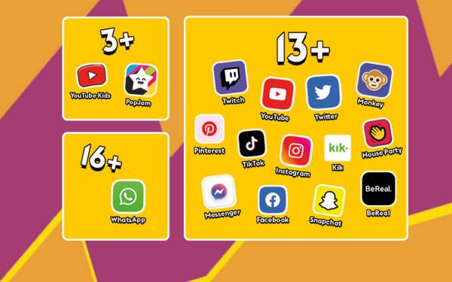
Online safety
Help us to keep your child ‘a child’ for as long as possible
Trends in behaviour show that children are far too aware of adult topics /language as a direst result of social media access
If your child has a device or phone, please check it regularly

Slide 21
Hot meals / Packed lunches
Hot meals are provided free of charge to all children up to Year 2.
Hot meals are payable for Years 3 – 6 unless in receipt of Pupil Premium funding.
If your child does not want a hot meal, you can provide them with a packed lunch.
If you would like your child to receive hot meals, please ensure you order from fresh start directly – information on the website

Slide 22
Contact us
At Tingewick, If you would like to contact any member of staff please send to admin@Roundwood.bucks.sch.uk with FAO and Mrs Hall will forward it to the correct member of staff for you
Alternatively, please call 01280 848306

