Slide 1

Meet the Teacher –
Year 1

Slide 2
Meet the Y1 Team
Mrs Field – Class teacher
Mrs Nichols – Teaching Assistant

Slide 3
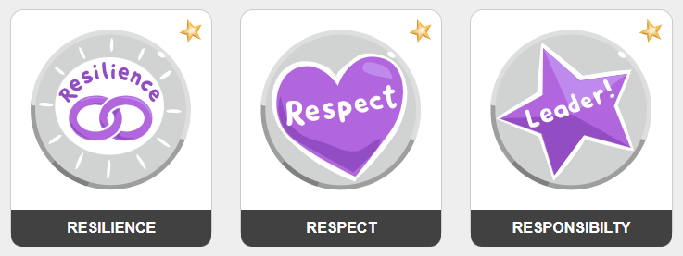
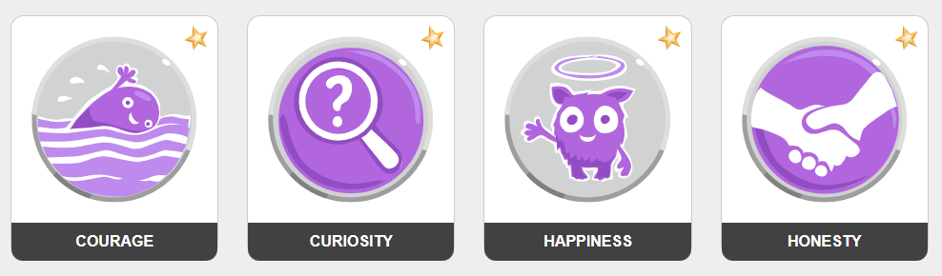
Our school values
We lead with nurture
Notes:
We aim to:
Inspire our children with the best the world has to offer whilst igniting a passion for learning, along with their enthusiasm and curiosity to explore
Challenge our children so that they strive to achieve their best, and to think to remember.
Grow our children so that they can converse, share in relationships and academically succeed beyond their time with us; being truly motivated by the successes and development they have made over time.

Slide 4
Marvellous Me
Informs parents about current learning and exciting opportunities in the classroom
Acts as a celebration platform where teachers share badges and thumbs up (house points)
Instant notifications for parents
Celebrated weekly in assembly
Creates a year book, each year, for child to revisit

Slide 5
Communication
Teacher on the door, morning and afternoon
Fortnightly bulletin
Website calendar which you can subscribe to
Parentmail
Marvellous Me
Emails to class teacher via the office
Refer to communication policy https://primarysite-prod-sorted.s3.amazonaws.com/roundwood-primary-school-redesign/UploadedDocument/018ce376-38db-41c1-83c0-a86f0b5b2a63/communications-final.pdf

Slide 6
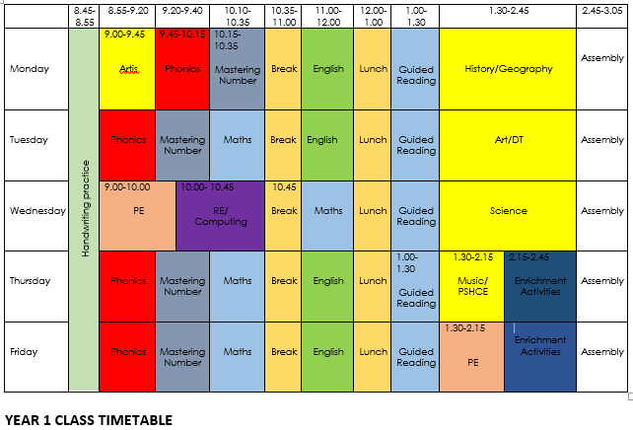
Our Timetable

Slide 7
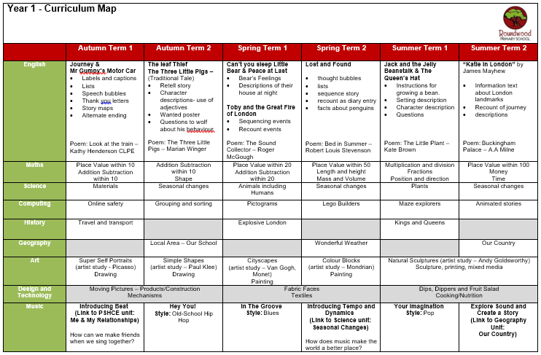
Our Curriculum

Slide 8
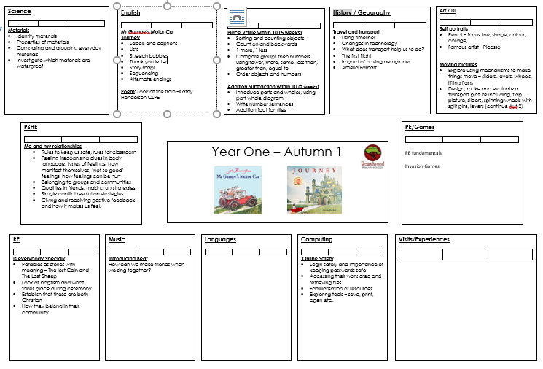
Autumn 1 Learning

Slide 9
Assessments
Year 1
Checks of phonic sounds – different points in the year
Reading of tricky words
End of term assessments – maths
Reading papers if the children are ready
Writing moderation takes place across school throughout the year
June – Phonics Screening Check

Slide 10
Homework – KS1
Numbots - I will print stickers with details to go on reading record books in September
HFW / Spellings (checked half termly at school and errors sent home to practice)
Reading books will be changed on a Tuesday
Additional homework can be completed – by utilising our Dip and Do

Slide 11
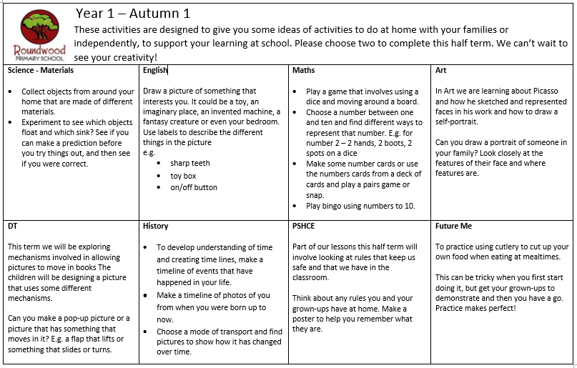
Dip and Do Homework tasks

Slide 12


Reading

Slide 13
Proposed Trips and Events
Waddesdon Trip is sometimes offered
End of Year 1 trip to the zoo - £34.50
Pantomine/cinema at Christmas
Trip to the library in Buckingham.
Walk to the church – related to RE work

Slide 14
Useful Information – Tingewick
Start of day is 8:45am
End of day is 3:15pm
Wraparound care run by S4A
Breakfast club open from 7:30am
Afterschool club open until 6:00pm
To book a session in S4A breakfast club or after school club. Go to the S4A website and click on Roundwood school

Slide 15
Useful Information – Tingewick
Book bags – rucksacks are not permitted
No toys or stationary to be brought in from home
Medical conditions / allergies must be detailed on a healthcare plan
If anyone else is picking your child up, please e-mail or call the school office otherwise we will not be able to send your child home

Slide 16
PE & Games – Tingewick
PE is on a Tuesday and Friday
Please come dressed in your PE Kit on both days
Please make sure you wear the correct uniform for PE, and not dress down clothes

Slide 17
Uniform – Tingewick
Red sweatshirt or cardigan with school logo
Plain white polo shirt or plain white blouse
Grey skirt/pinafore/trousers/shorts; traditional school style
Grey short socks
White long socks
Red or grey tights
Black leather school shoes (not trainers)
Red and white gingham dress or playsuit
All children require a bookbag, water bottle and wellington boots

Slide 18
Uniform – Expectations
Long hair / and or fringes must be tied back
Studs for pierced ears
No other jewellery permitted (unless for religious reasons)
No make up
No nail varnish
No extreme hair cuts e.g. mullets / close shaven
No hair dye

Slide 19
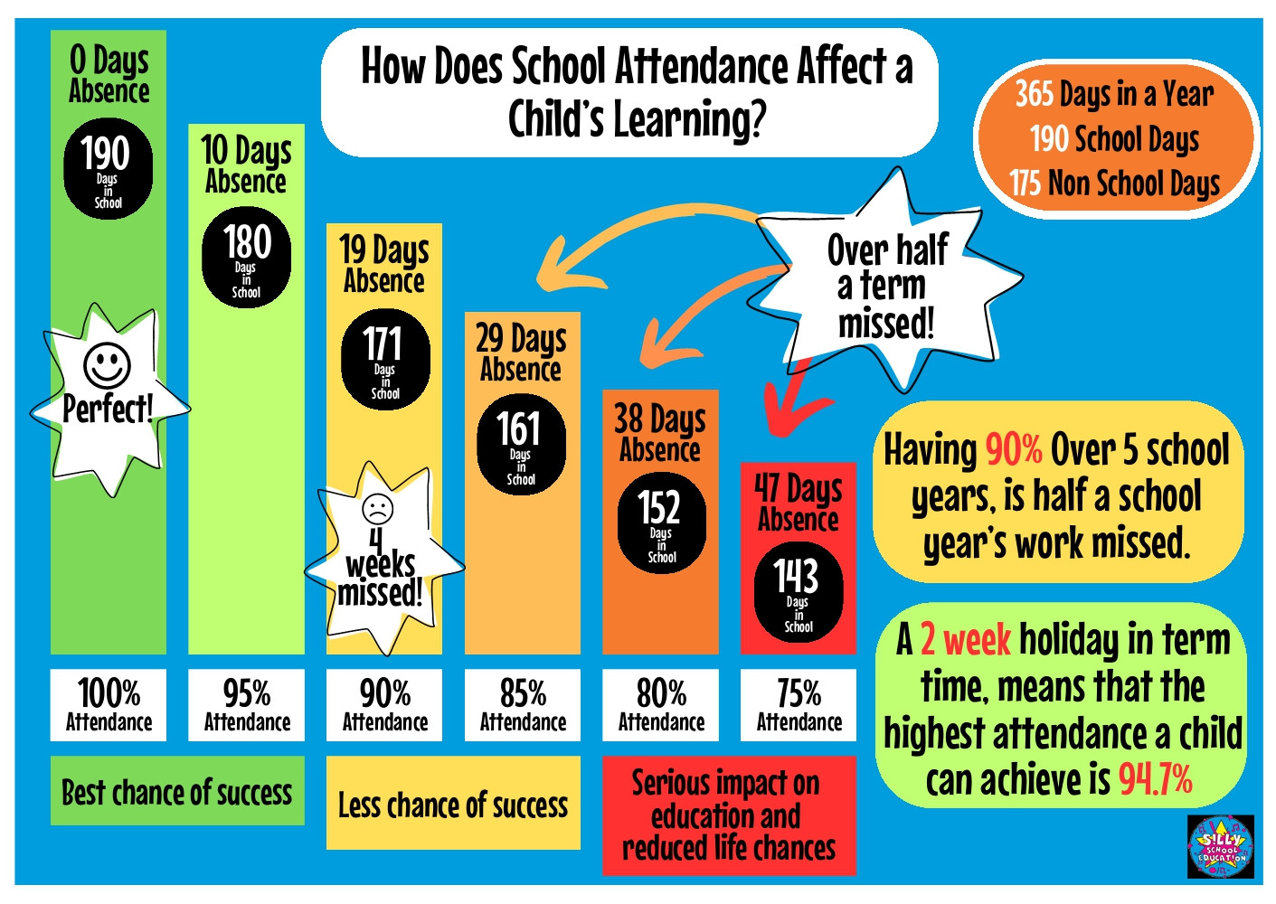
Attendance – it really does matter!
Notes:
Please be awae that

Slide 20
Behaviour
All behaviour incidents are reported on our CPOMS behaviour system
All physical and swearing incidents will receive a call home
We are launching a kindness campaign in September to help us stamp out low level unkind behaviours – we will ask for your support with this

Slide 21
Support from home
Make sure your child arrives on time each morning
Support your child with reading, spelling and homework
Empty bookbags / bags
Keep us informed of anything that may affect your child’s learning or happiness
Regularly check Marvellous Me, Parentmail and school calendar on the school website

Slide 22
Hot meals / Packed lunches
Hot meals are provided free of charge to all children up to Year 2.
If your child does not want a hot meal, you can provide them with a packed lunch.
If you would like your child to receive hot meals, please ensure you order from fresh start directly – information on the website

Slide 23

Questions

