Slide 1

Welcome
2024 Meeting for New Parents

Slide 2
Introductions
Headteacher – Mrs Handley
Deputy Headteacher – Mrs Clarke
Practitioners – Miss Hicks, Miss Connell, Mrs Nichols
School Administrator – Mrs Hall
Uniform Representative – Maria – Rio Workwear
Sports 4 All – Joe Merry

Slide 3
Starting School
Line up on the playground
Leave their named belongings in basket
Try to make drop off as swift as possible
Provide some spare clothes (toileting accidents when they start school are very normal)
Bring in a photo from their summer holidays
Transition Book – if you haven’t sent it back already

Slide 4
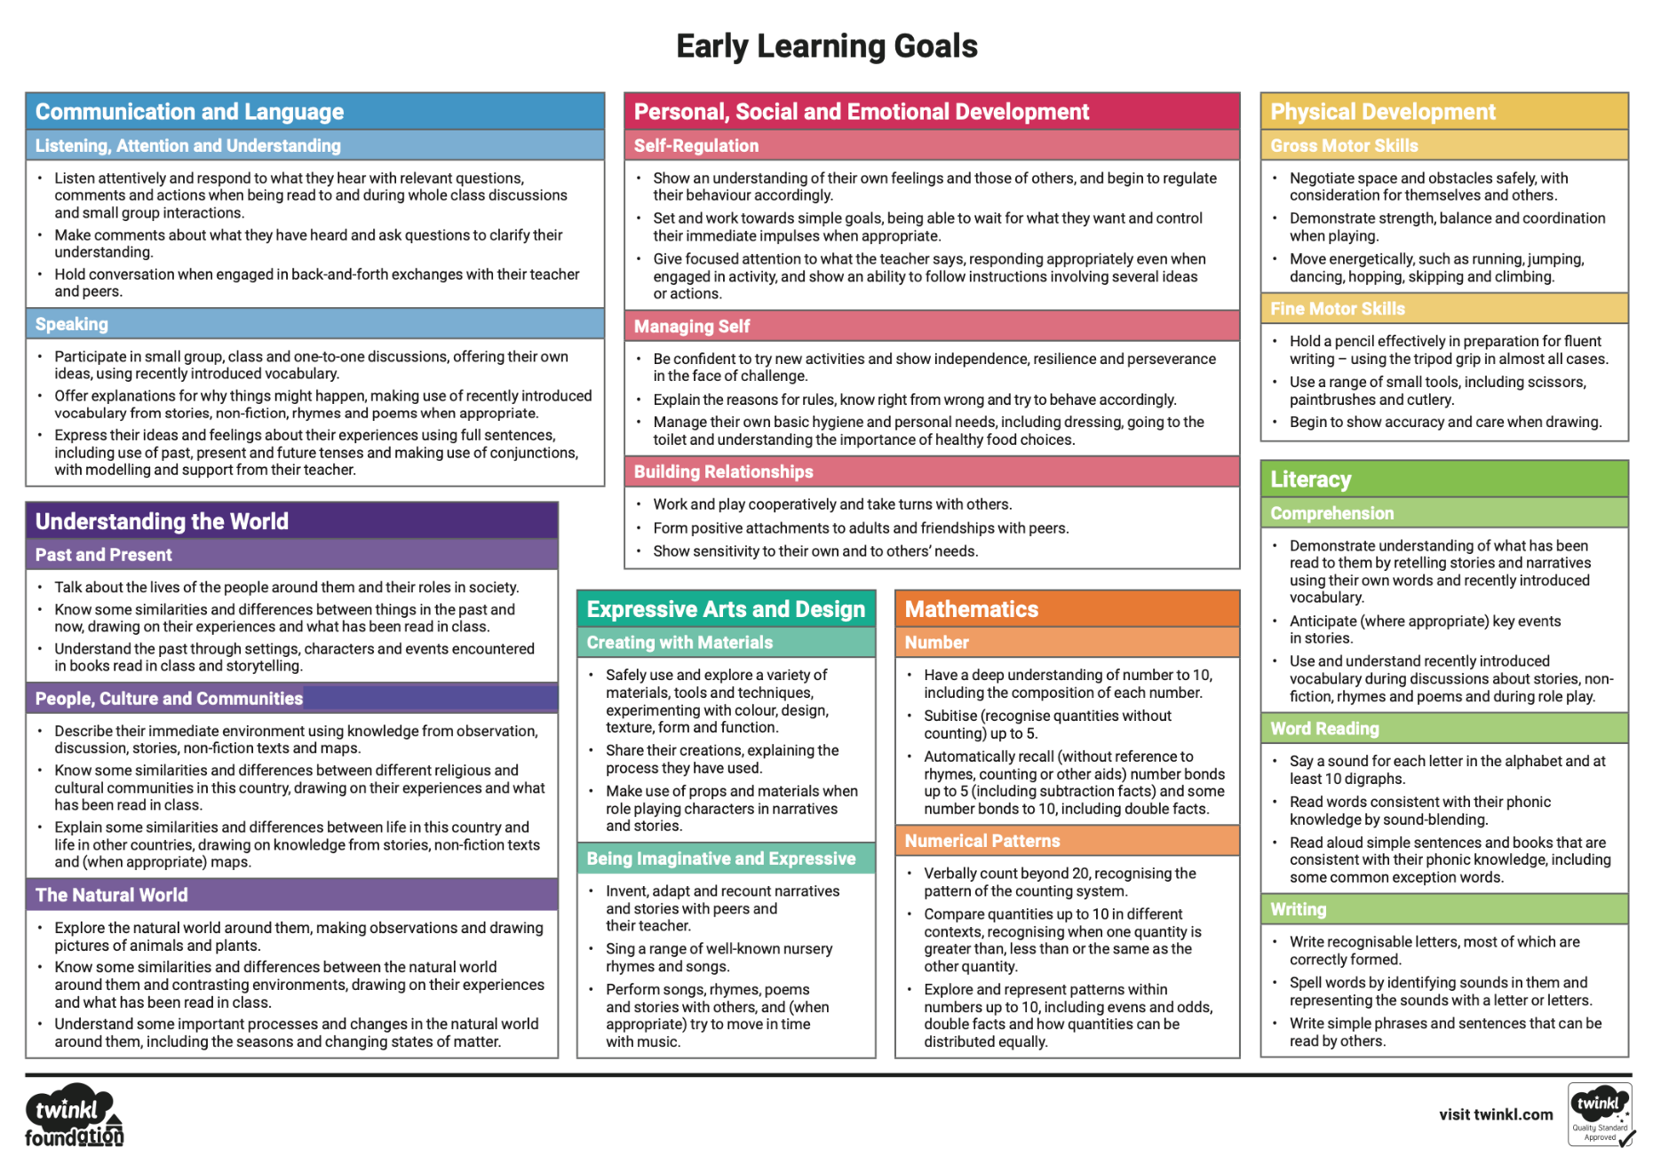
Early Learning Goals
Communication and Language
Personal, Social and Emotional Development
Physical Development
Literacy
Mathematics
Understanding the World
Expressive Arts and Design

Slide 5
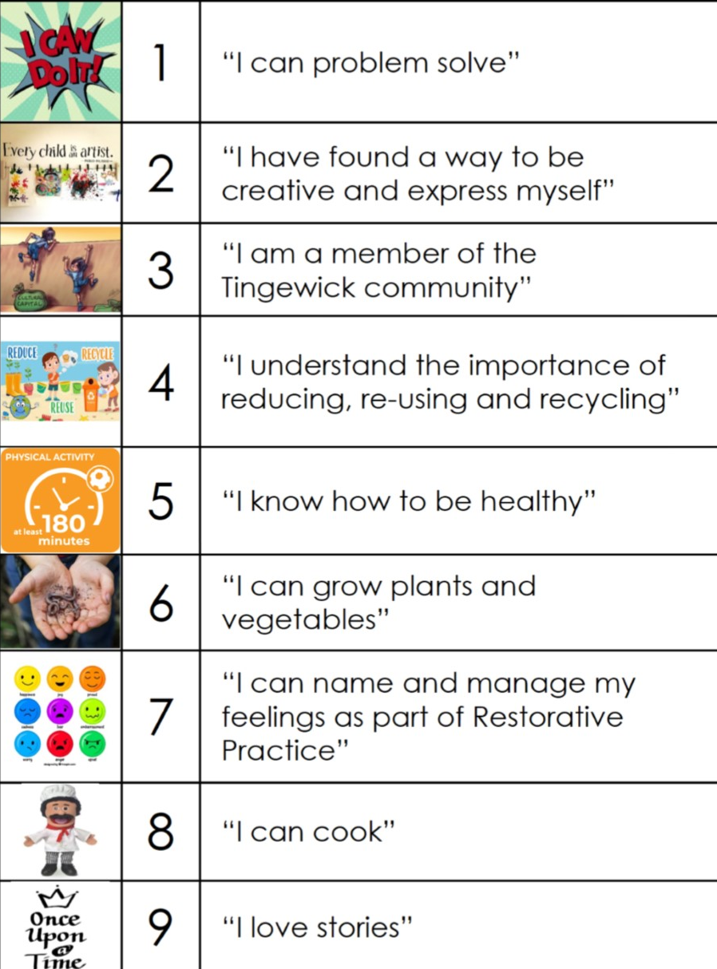
The EYFS Curriculum at Roundwood Primary School
Bespoke
Planning
Tapestry

Slide 6

The EYFS Curriculum at Roundwood Primary School

Slide 7
Register
Phonics
Snack
Play
Maths
Lunch
Play
Continuous Provision – open ended overarching aims
Example Timetable

Slide 8

Secure online portal we use for sharing learning intentions, outcomes and celebrations throughout EYFS
App available
Updates you via email of new observations
You can upload your own observations – children love it when this happens!
You can have more than one parent per account
If you currently have an account it can be transferred to us
Self-help tutorials for parents online

Slide 9
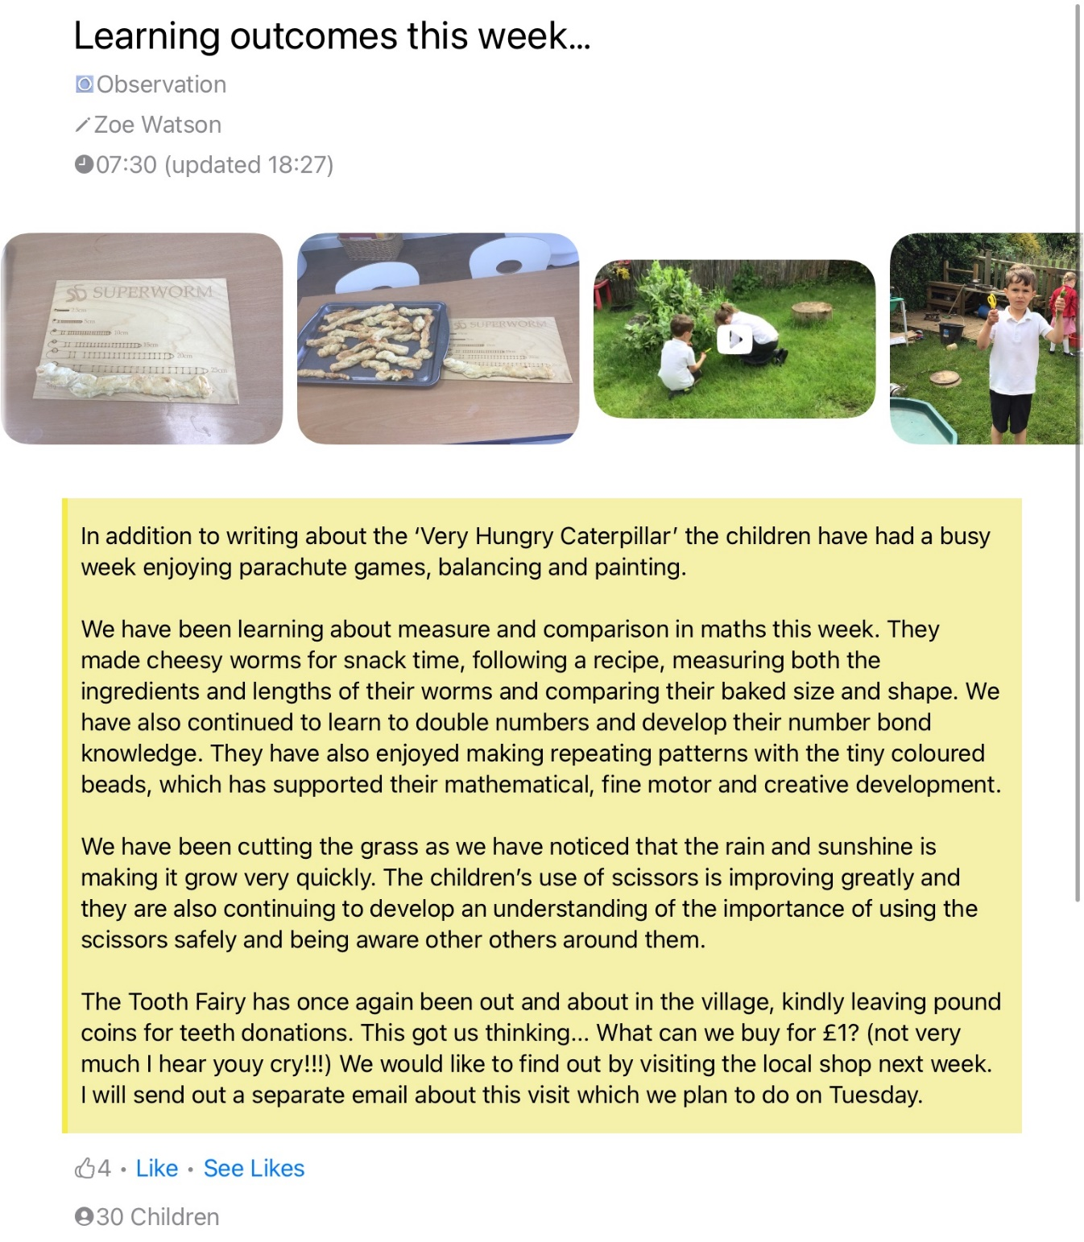
Learning Outcomes…

Slide 10
September…
All children will be in school full time from Thursday 4th September
Full time – child dependent
The school day begins at 8.45am and ends at 3.15pm
PE is on a Wednesday

Slide 11
Events
Christmas performance will be an EYFS only performance – sing and share
Trip - to Waddesdon in the Spring Term
Summer Term trip will also be organised later in the year and you will be informed in plenty of time. (This year, we went to Hogshaw Farm)

Slide 12
Uniform
Red sweatshirt or cardigan
Plain white polo shirt or plain white blouse
Grey skirt/pinafore/trousers - no track suits or jeans, no jersey or legging material
Grey or black short socks
White long socks or red or grey tights
Black leather school shoes – no trainers
Summer – Red and white gingham dress/Grey shorts
Bookbag – no backpacks
Forest School kit – waterproof trousers, jacket and wellies
PE kit – red T-shirt, black shorts and trainers
See website for full policy

Slide 13
Food
We provide a snack – we sometimes make it and are supplied with fruit
Water bottles will be needed every day
Hot lunches are provided for free until children move into Key Stage 2 (at Gawcott)
Order in good time and if you don’t have access to tech, see Mrs Hall

Slide 14
My top tips…
Good routines
Read lots of stories
Transitional object
Name everything
Ensure children are able to use the toilet independently
Go to the website for information and sync the school calendar!
Try not to worry and enjoy the summer!

Slide 15
Any Questions?

Slide 16

Thank you for coming!

Slide 17
Contact details
Jo Hall - admin@roundwood.bucks.sch.uk

